Slide 1












DTX NEW NORDICS CONFERENCE
KEYNOTES:
27 August 2025
Tartu, Estonia
Online
www.dtxnewnordics.com
Mélodie BERNAUX
Elizabeth JENNINGS
Leon DOORN

Slide 2
AGENDA:
www.dtxnewnordics.com
09:30 – 10:00 Registration & Coffee
10:00 – 10:15 Opening & Keynote – Karmen Joller, Minister of Social Affairs
10:15 – 10:30 Keynote – Mélodie Bernaux, European Commission
10:30 – 11:30 Session I: The Digital Health Frontier
11:30 – 12:00 Coffee Break
12:00 – 13:15 Session II: New Nordics & Gulf Collaboration
13:15 – 14:15 Lunch
14:15 – 14:30 Keynote – Leon Doorn, MedQAIR
14:30 – 15:30 Session III: European Health Data Space
15:30 – 16:00 Coffee Break
16:00 – 16:20 Inspirational Keynote – Elizabeth Jennings
16:20 – 17:05 Session IV: Best Practices – Singapore & Australia
17:05 – 17:15 Closing Remarks

Slide 3
Karmen Joller
Minister of Health,
Ministry of Social Affairs

Slide 4
Panel discussion: The Digital Health Frontier - Opportunities and Challenges
Moderator: Dr Jaanus PIKANI, Chairman of ScanBalt | Member of the Board, Tartu Biotechnology Park
Panellists:
  Mélodie BERNAUX, Policy Officer – Seconded National Expert | European Commission (DG SANTE, Unit C1 – Digital Health)
  Nele LABI, Deputy Secretary General | Estonian Ministry of Social Affairs
  Daniel NAUMOVAS, Vice-Minister of Health | Republic of Lithuania
  Aiga BALODE, Deputy State Secretary | Latvian Ministry of Health
  Michel SILVESTRI, Head of Unit, Coordination Department | Swedish eHealth Agency
  Sari PALOJOKI, Senior Advisor & Team Leader for International Digitalisation Policy, PhD | Finnish Ministry of Social Affairs and Health

Slide 5

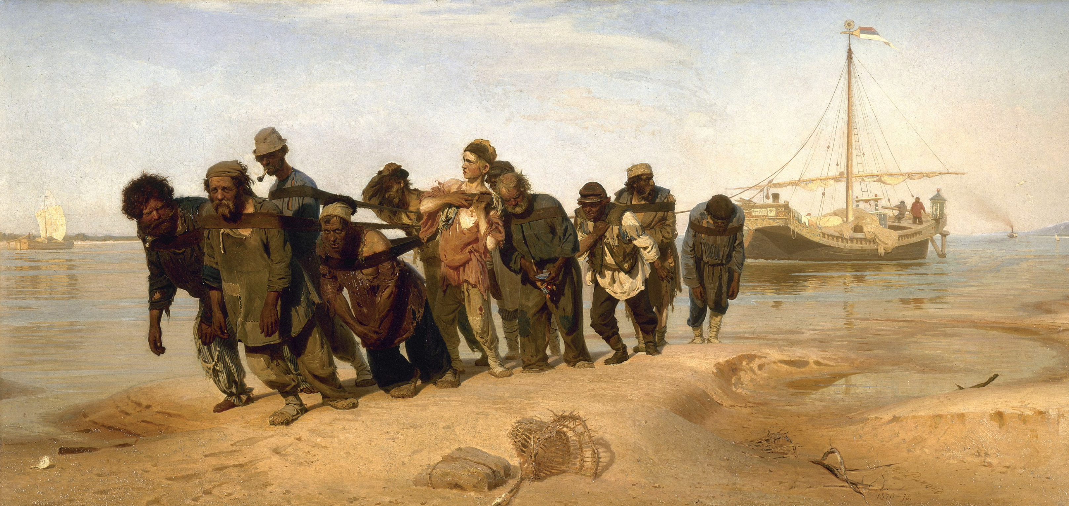
Barge Haulers on the Volga Painting by Ilja Repin
The State Russian Museum
Aknowledgement to Lars Linköldd

Slide 6
Barge Haulers on the Volga Painting by Ilja Repin
The State Russian Museum
Aknowledgement to Lars Linköldd

Slide 7
Keynote:
“EHDS – Unlocking health data-driven innovation in Europe
Dr. Mélodie Bernaux
Policy officer – Seconded national expert | European Commission, Directorate-General for Health and Food Safety, Unit C1 - Digital Health

Slide 8
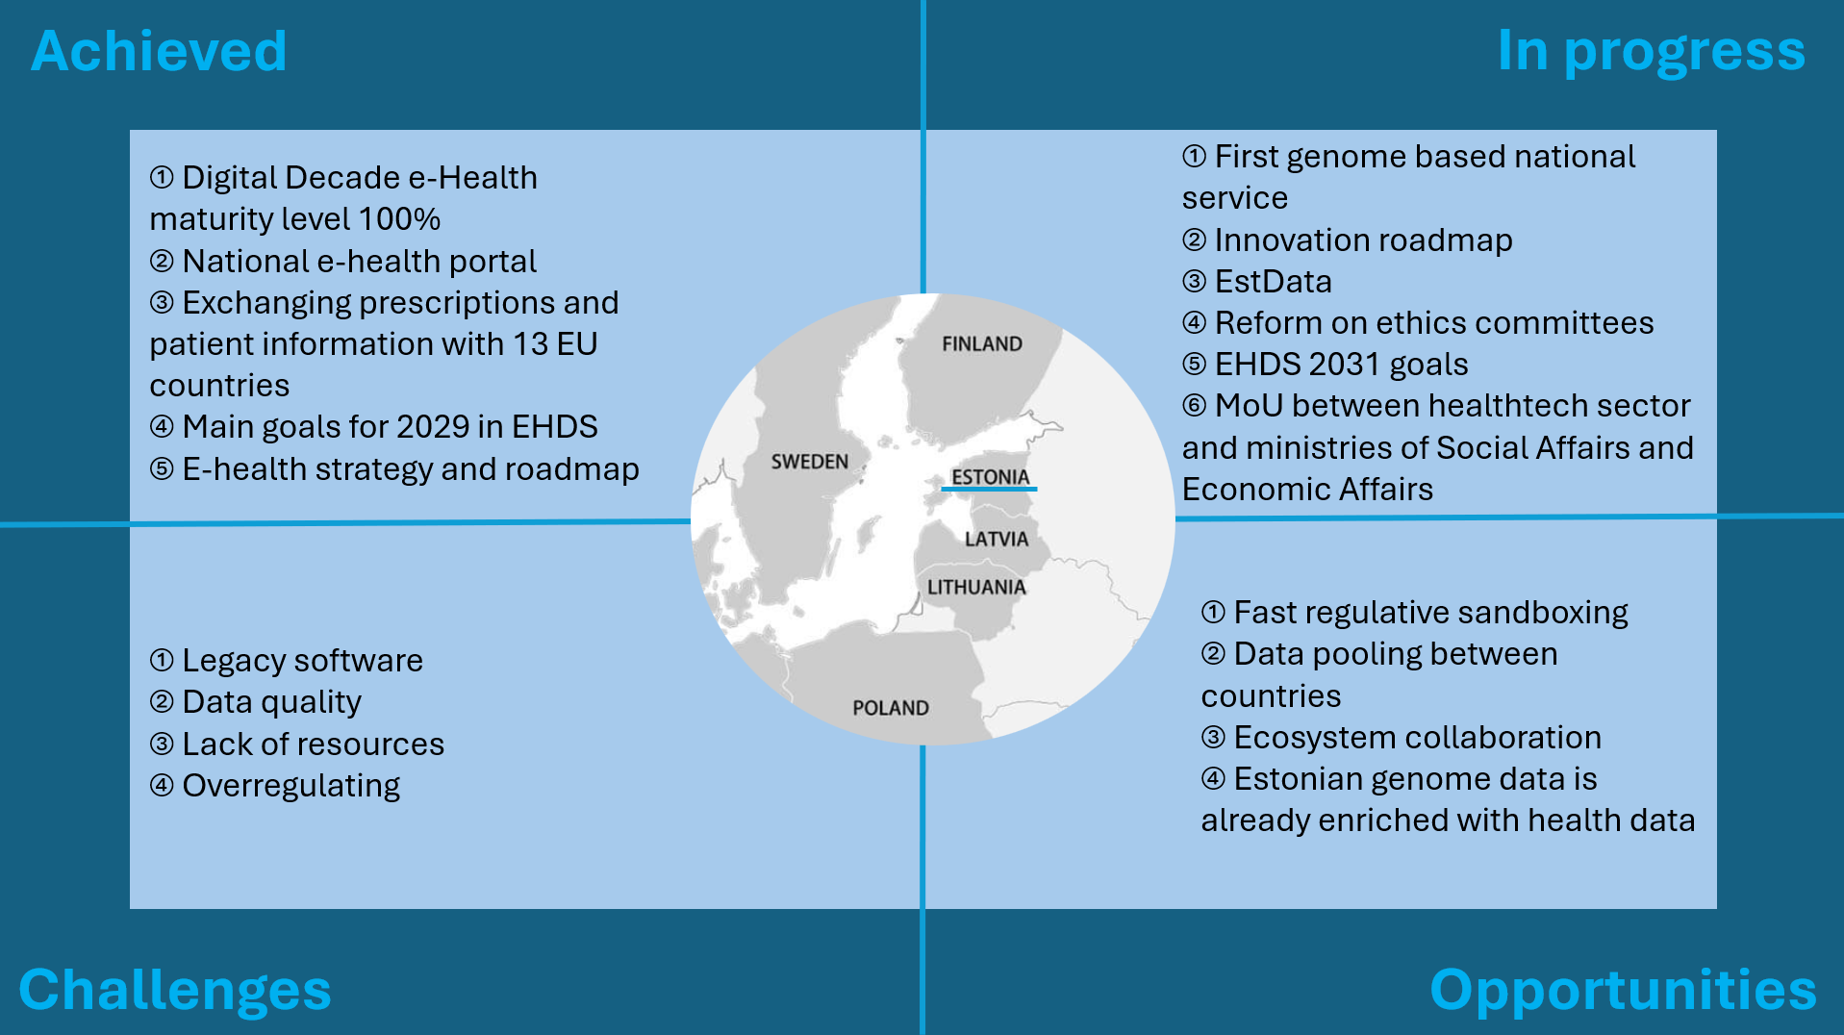

Slide 9
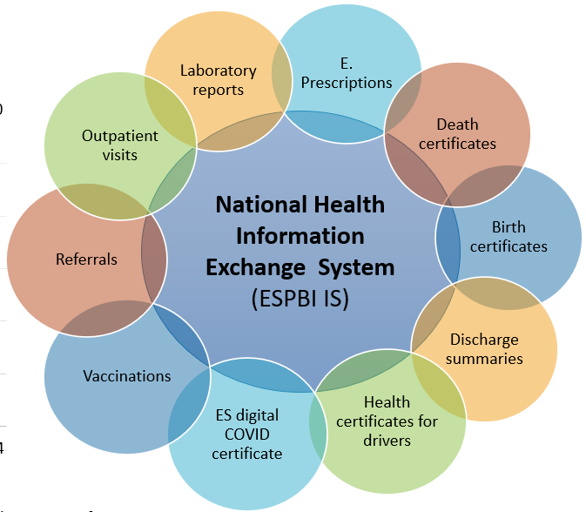

Digital Health in Lithuania
Annual number of EHR records per year
The exchange of ePrescriptions and electronic dispensing information with EU Member States has already been deployed and is operational, while preparations are underway for the exchange of patient summary data (MyHealth@EU).
Lithuania is among the few European countries that have enabled the secondary use of health data.

Slide 10
Challenges (EHDS: Vision vs. Reality)
EHR systems will be required to comply with mandatory components: EHR system interoperability and EHR system registration. It is not yet clear whether the requirements will apply solely to the main national information system or will also be mandatory for all information systems used by healthcare providers and pharmacies (primary use);
Lithuania expressed concerns that the application of an opt-out mechanism for secondary data use would negatively affect the quality of research data due to data shortages (secondary use);
The implementation of EHDS requires significant preparation, demanding human resources (with at least 15 legal acts are expected to be amended), financial resources (healthcare institutions are deeply concerned about the requirements imposed on hospital information systems), time, and expertise;
Substantial changes in national legislation, public awareness, trust, and the active involvement of both the Centre of Registers (responsible for primary use of health data) and the State Data Agency (responsible for secondary use);
Health data maturity is insufficient to meet the needs of different stakeholders. Legacy clinical documentation with low quality;
Non-digital mentality and digital skills.

Slide 11
A Swedish perspective
Michel Silvestri, PhD, Senior Advisor
Swedish eHealth Agency
DTx Conference, Tartu
2025-08-27
michel.silvestri@ehalsomyndigheten.se

Slide 12

Proposed roadmap for national digital infrastructure
Government takes main responsibility for infrastructure
Used by all stakeholders
Aligned with EHDS requirements
Collaboration!
Notes:
Vad föreslår vi?
Staten tar ett större ansvar för en reformerad nationell infrastruktur baserad på modern arkitektur och gemensamma standarder.
Infrastrukturen som byggs ska bland annat utgöra stommen för det eko-system som hälsodataområdet utgör.
Infrastrukturen bör byggas modulärt vars delar är löst kopplade till varandra och relativt tekniskt fristående. Delarna bildar snarare ett pussel av delar där varje del kan utvecklas löpande och frikopplat från övriga.
För att få en långsiktigt hållbar digital infrastruktur krävs en funktion för stöd och styrning som involverar hela sektorn.
Infrastrukturen möjliggör för aktörerna inom sektorn att utveckla tjänster som använder sig av infrastrukturen. Tillsammans bildar det ett ekosystem för delning av information.
Ineras digitala infrastruktur och kompetens är fortsatt viktig för hälso- och sjukvården, omsorgen och tandvården, men färdplanen föreslår inte förvärv av Inera i sin helhet.
I den mån det är möjligt bör man dra nytta av befintliga system och infrastruktur och bygga vidare på dessa för att tillgodose både nuvarande och framtida användning.

Slide 13
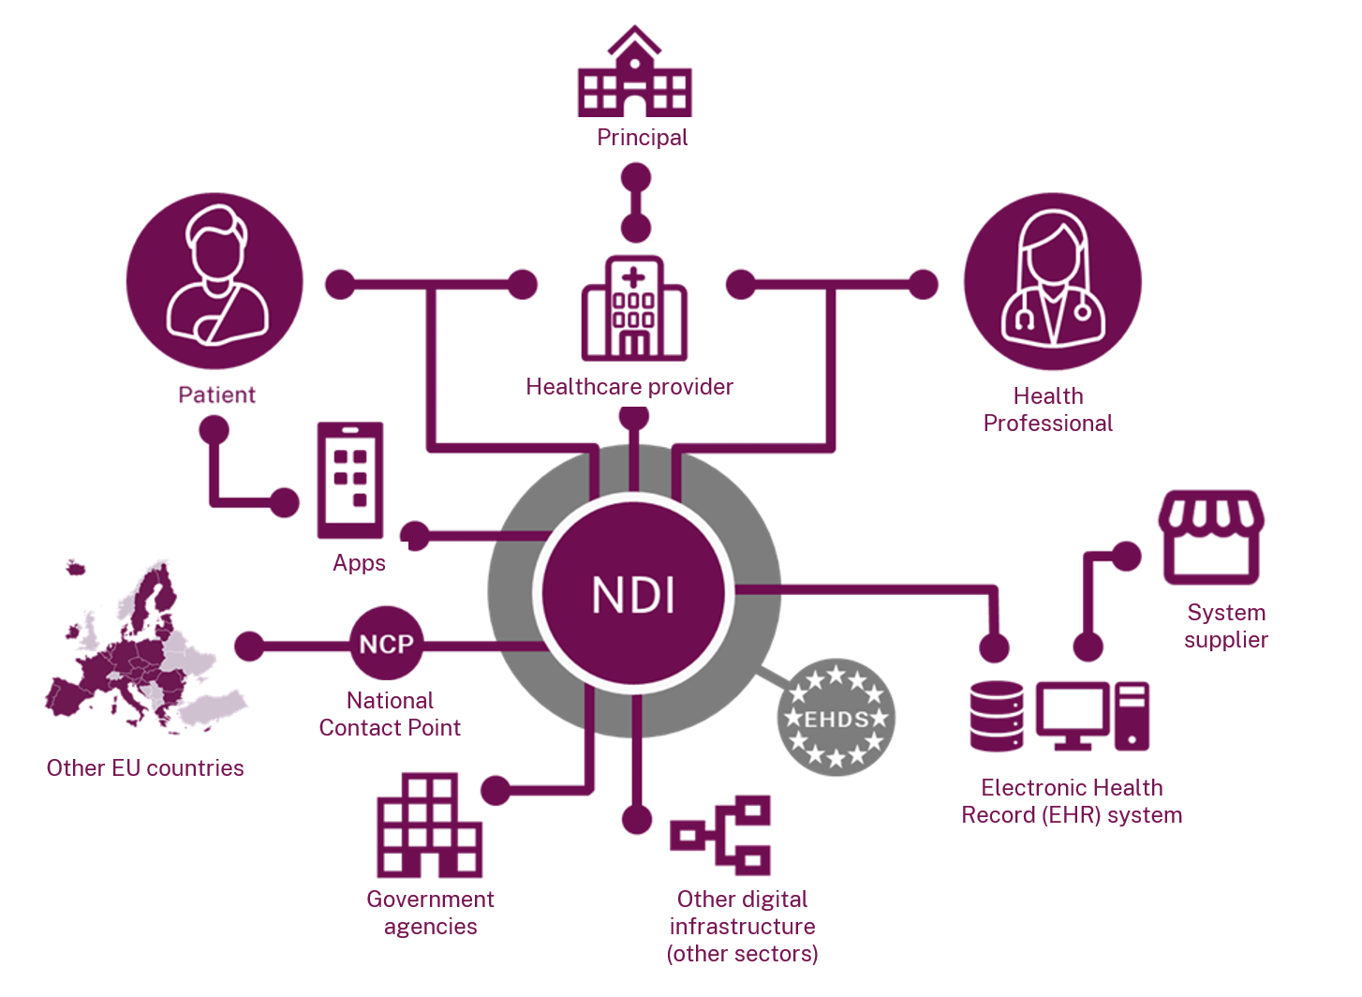

Slide 14








Nordic joint preparations of EHDS2
https://www.sitra.fi/en/projects/value-from-nordic-health-data-valo/

Slide 15
The Digital Health Frontier: Opportunities and Challenges
Sari Palojoki
Senior Advisor, PhD
Team Leader of International Health Digitalization Policy Affairs / Department of Steering in Social Welfare and Health

Slide 16
The Evolution of National Health Digitalisation in Finland
Act on the
Electronic
Processing of
Client Data in Healthcare and
Social Welfare
My Kanta Pages
Kanta PHR
E-prescription
Patient
Data Repository
Kanta data warehouse
Client data archive for social welfare services
Pharmaceutical database
Kanta data lake
Kelain
EHDS
2007
2009
2010
2013
2016
2017
2018
2019
2020
2021
Kanta
Ekstranet
Healthcare data
Oral healthcare data
Archive of
imaging data
Cross-border prescription
Client Data Act
and prescription
act are reformed
Delivery of medical certificates
Act on
secondary
use of health
and social data approved
Kanta.fi
Archiving of old patient data
Delivery of medical certificates to Kela

Slide 17
Current Finnish core competence areas in health digitalisation
Secondary use of social and health data
Age tech - technology solutions in care for
older people
Artificial intelligence in the health and social services sector
Expert and consultancy services on the digitalisation
of the healthcare and social welfare sector

Slide 18
11:30 -12:00
Coffee Break

Slide 19
Panel discussion: Unlocking New Horizons: Business and Collaboration between the New Nordics and Gulf region
Moderator: Ain AAVIKSOO, Head of Development | Partner at Heba, Senior Business Advisor at Nortal
Panellists:
  Dr Khulood ALSAYEGH, Senior Healthcare Leader | AI & Precision Medicine Pioneer | Head of Clinical Standards & Guidelines, Dubai Health Authority
  Taavi EINASTE, CEO MEA and Partner | Nortal
  Walid KATTAN, Regional Director | BeeHealthy
  Piret SAUTER, Regional Director of Distant Export Markets | Estonian Business and Innovation Agency

Slide 20
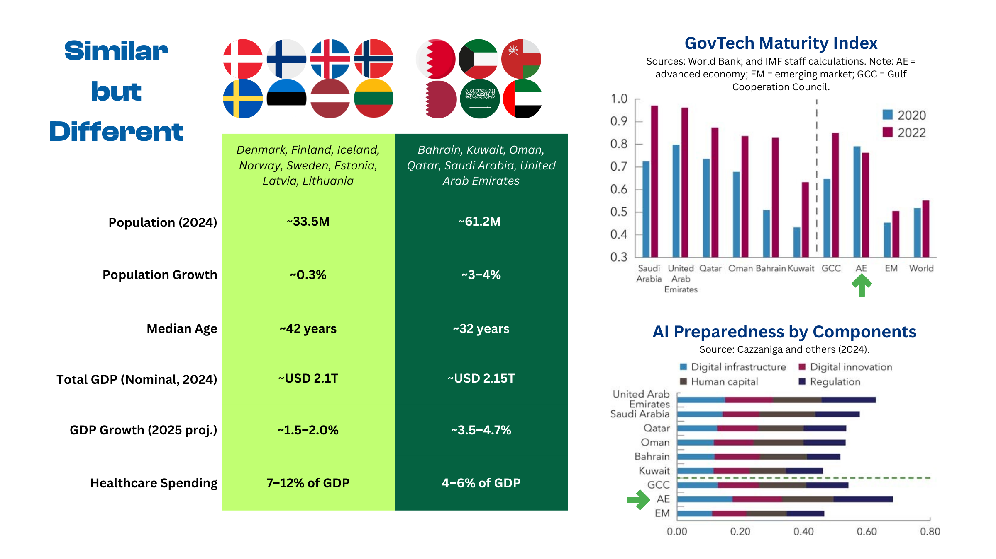

Slide 21


Healthcare in the UAE..
… With a Focus on Dubai
Dr Khulood Alsayegh
Health Regulation
Dubai Health Authority

Slide 22

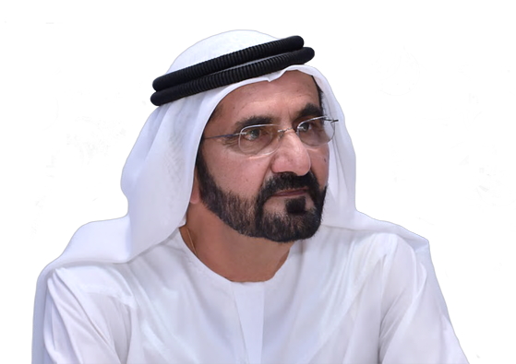
“I want Dubai to be number one. Not in the region, but in the world.”
“Number one in everything: high education, health, and housing.”
“I want to give my people the highest way of living”.
H.H. Sheikh Mohammed Bin Rashid Al Maktoum
Vice President
Minister of the UAE and Ruler of Dubai

Slide 23






Dubai
A global hub for healthcare
Strategic location between Europe, Africa and Asia
~44.1% population growth during the past 10 years
3.5m population in Dubai in 2022
5.8m projected population by 2040
Source: 2040 Urban Master Plan

Slide 24
Agenda
Healthcare Infrastructure
Healthcare Expenditure
Health Tourism
Health Information System
AI in Healthcare
Future shaping and investment opportunities

Slide 25
Healthcare
Infrastructure
01

Slide 26
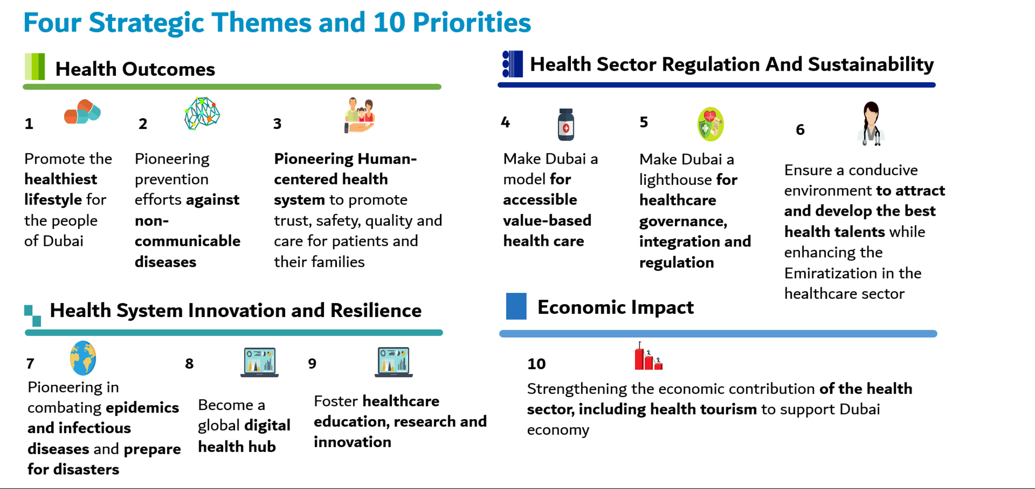

Slide 27
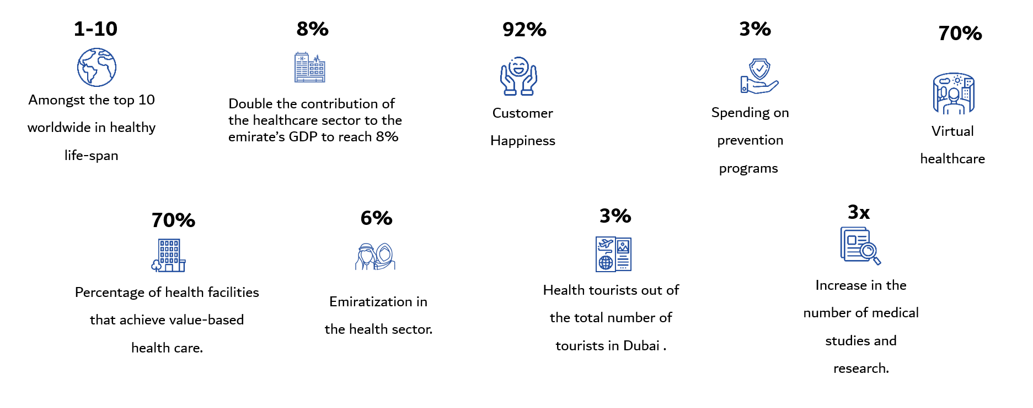

Slide 28
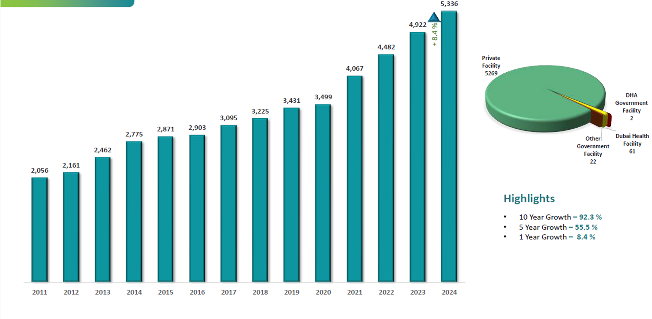
Health Facilities Growth
Source: DHA Health licensing Department

Slide 29
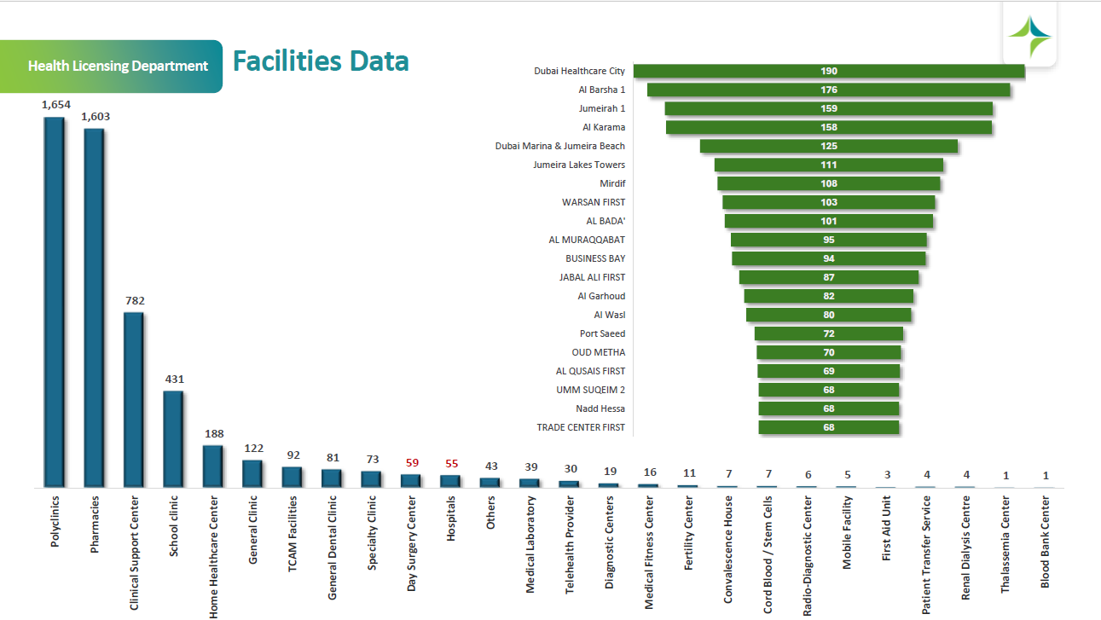
Health Facilities Subtypes
Source: DHA Health licensing Department

Slide 30
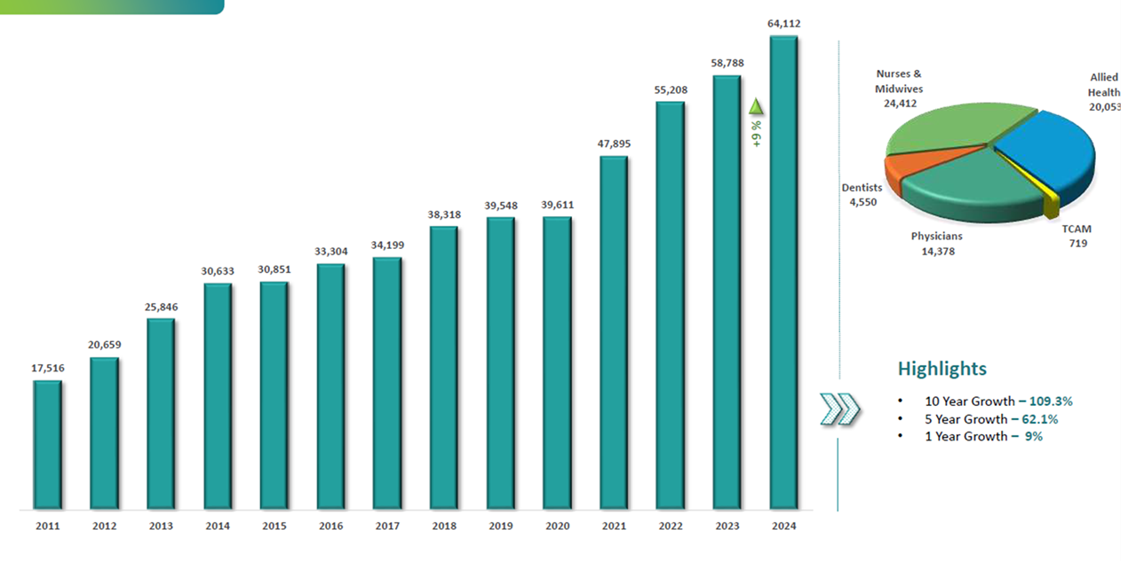
Health professionals Growth
Source: DHA Health licensing Department

Slide 31
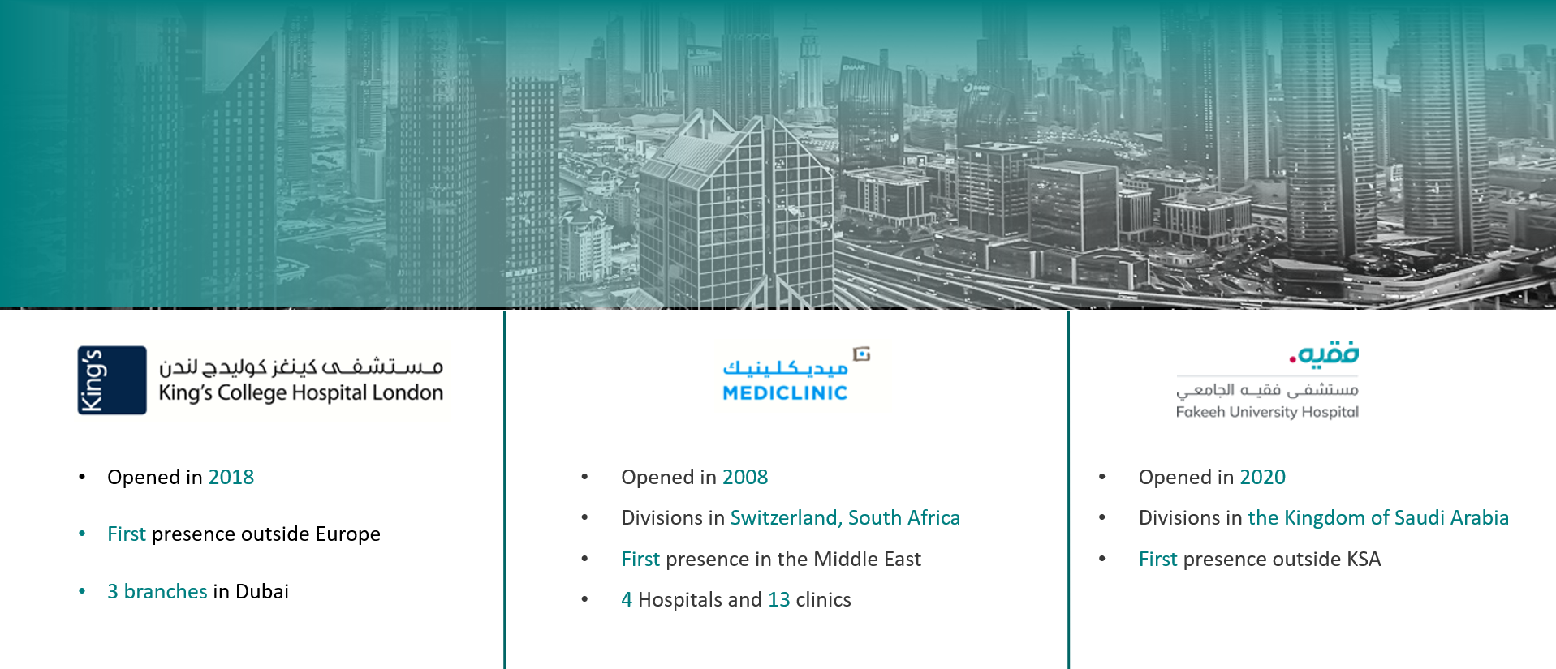
Dubai became the destination of choice for world-renowned healthcare providers to settle.. and grow…

Slide 32
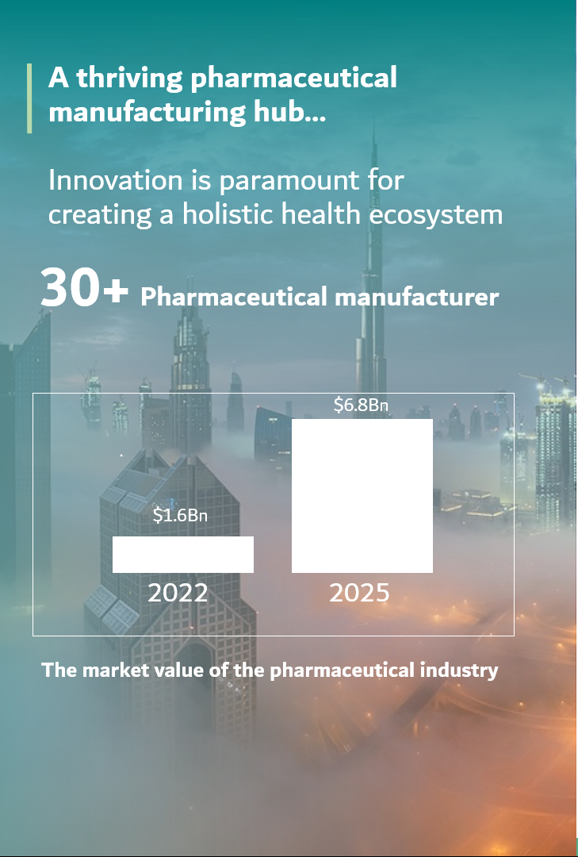
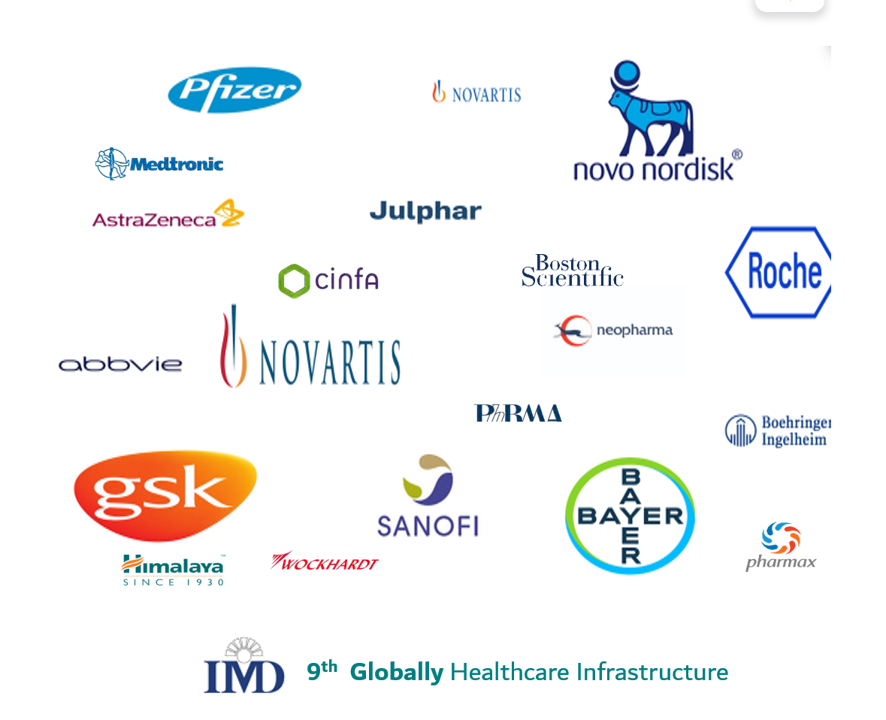

Slide 33
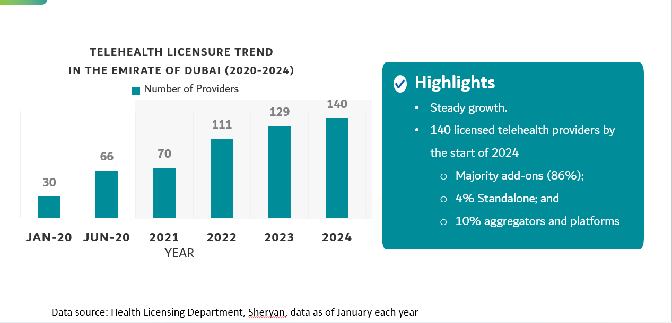
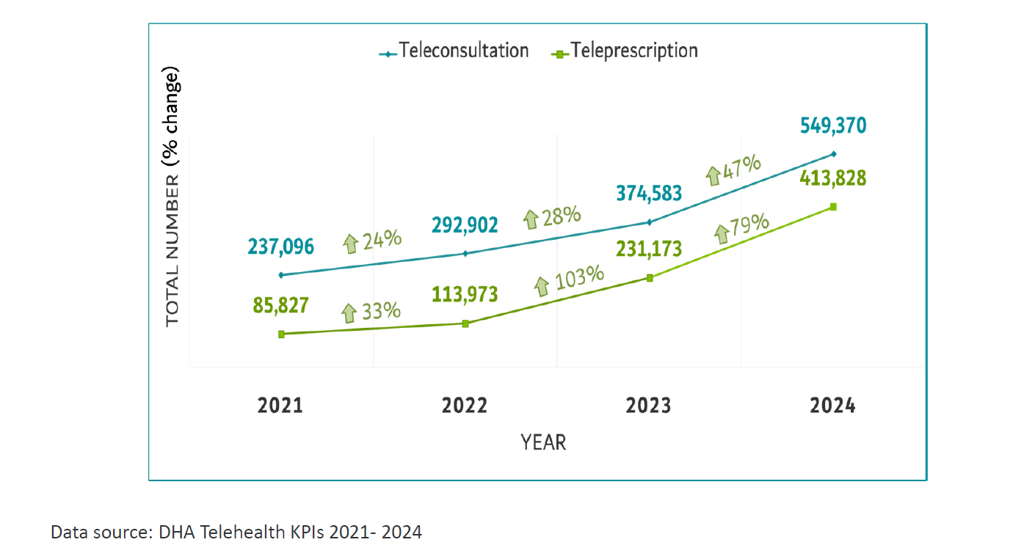
Telehealth Growth

Slide 34
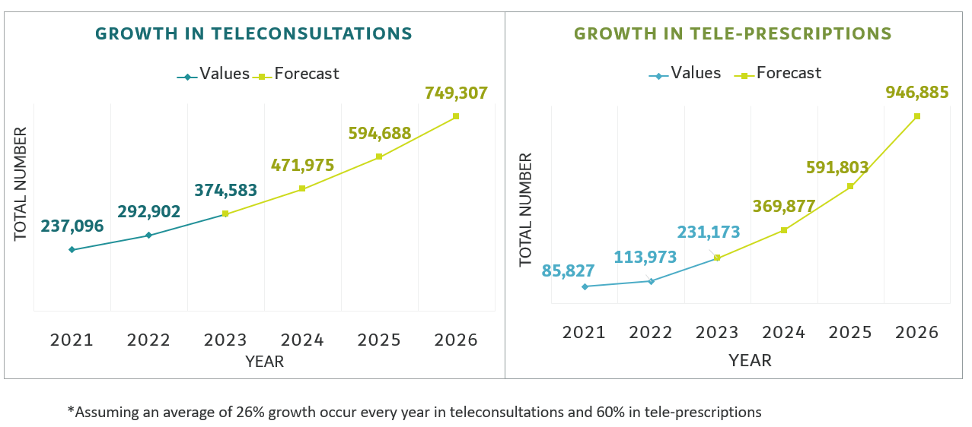
Growth Projections

Slide 35
Healthcare
Expenditure
02

Slide 36
Mandatory Health Insurance
4.9 M+ Insured members via government and private insurance schemes
97.22 M+ submitted claims
100% Insured population
Eur 3.45 billion+ Gross claims value

Slide 37
Health
Tourism
03

Slide 38
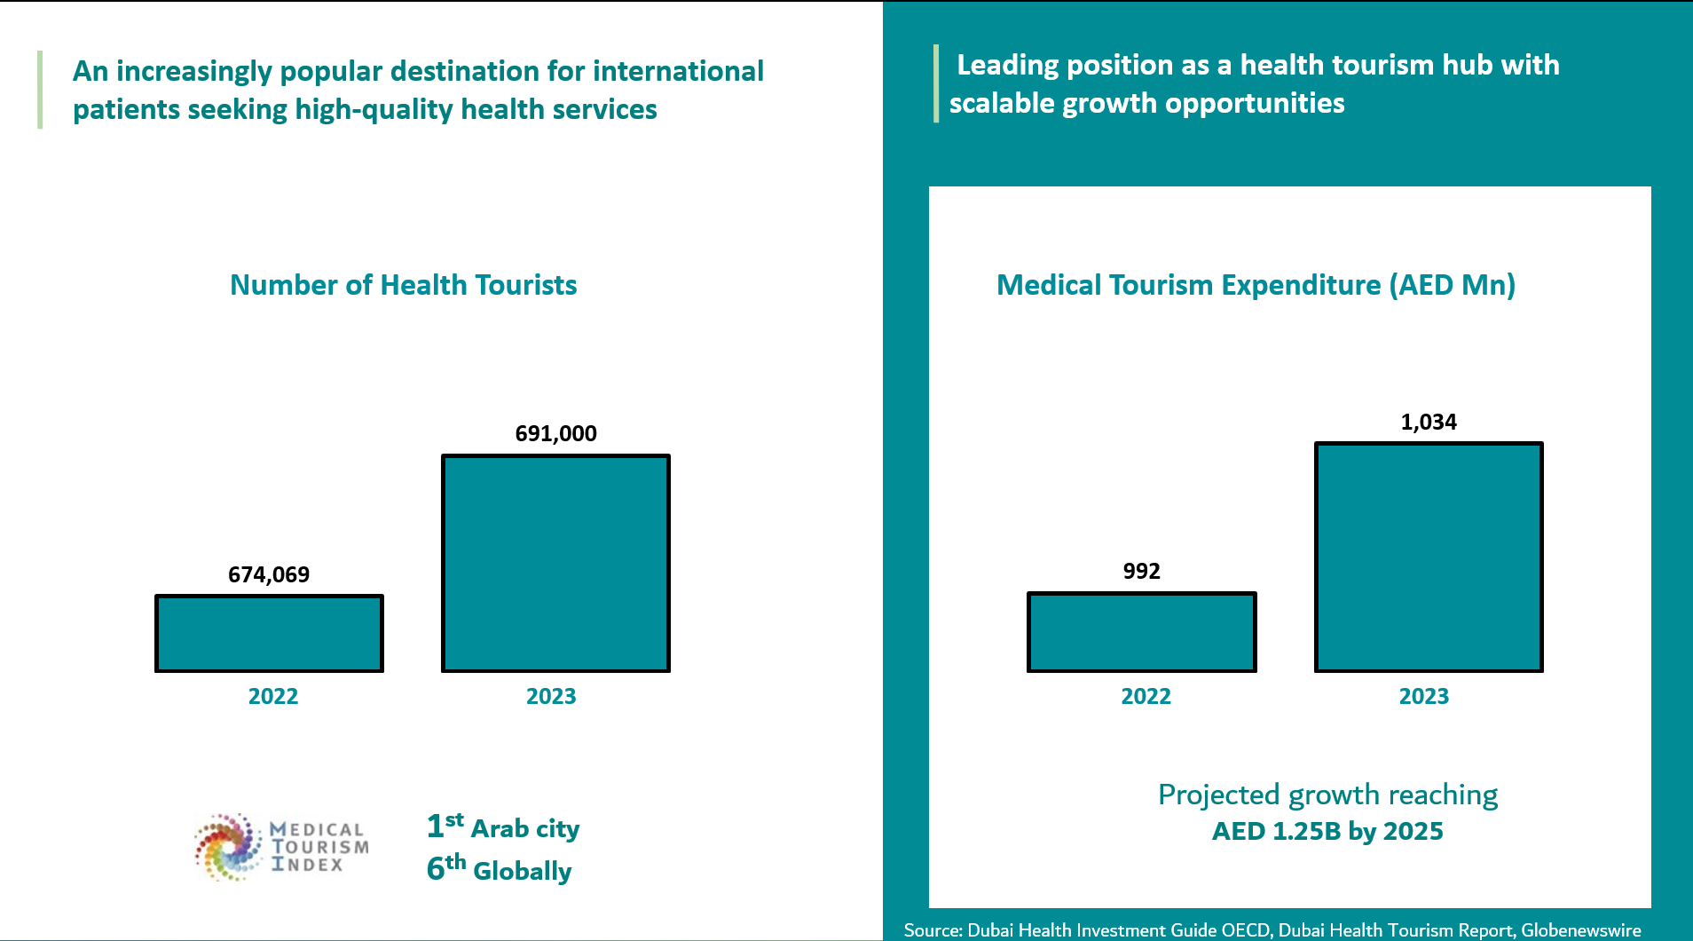
EUR 290M in 2025

Slide 39
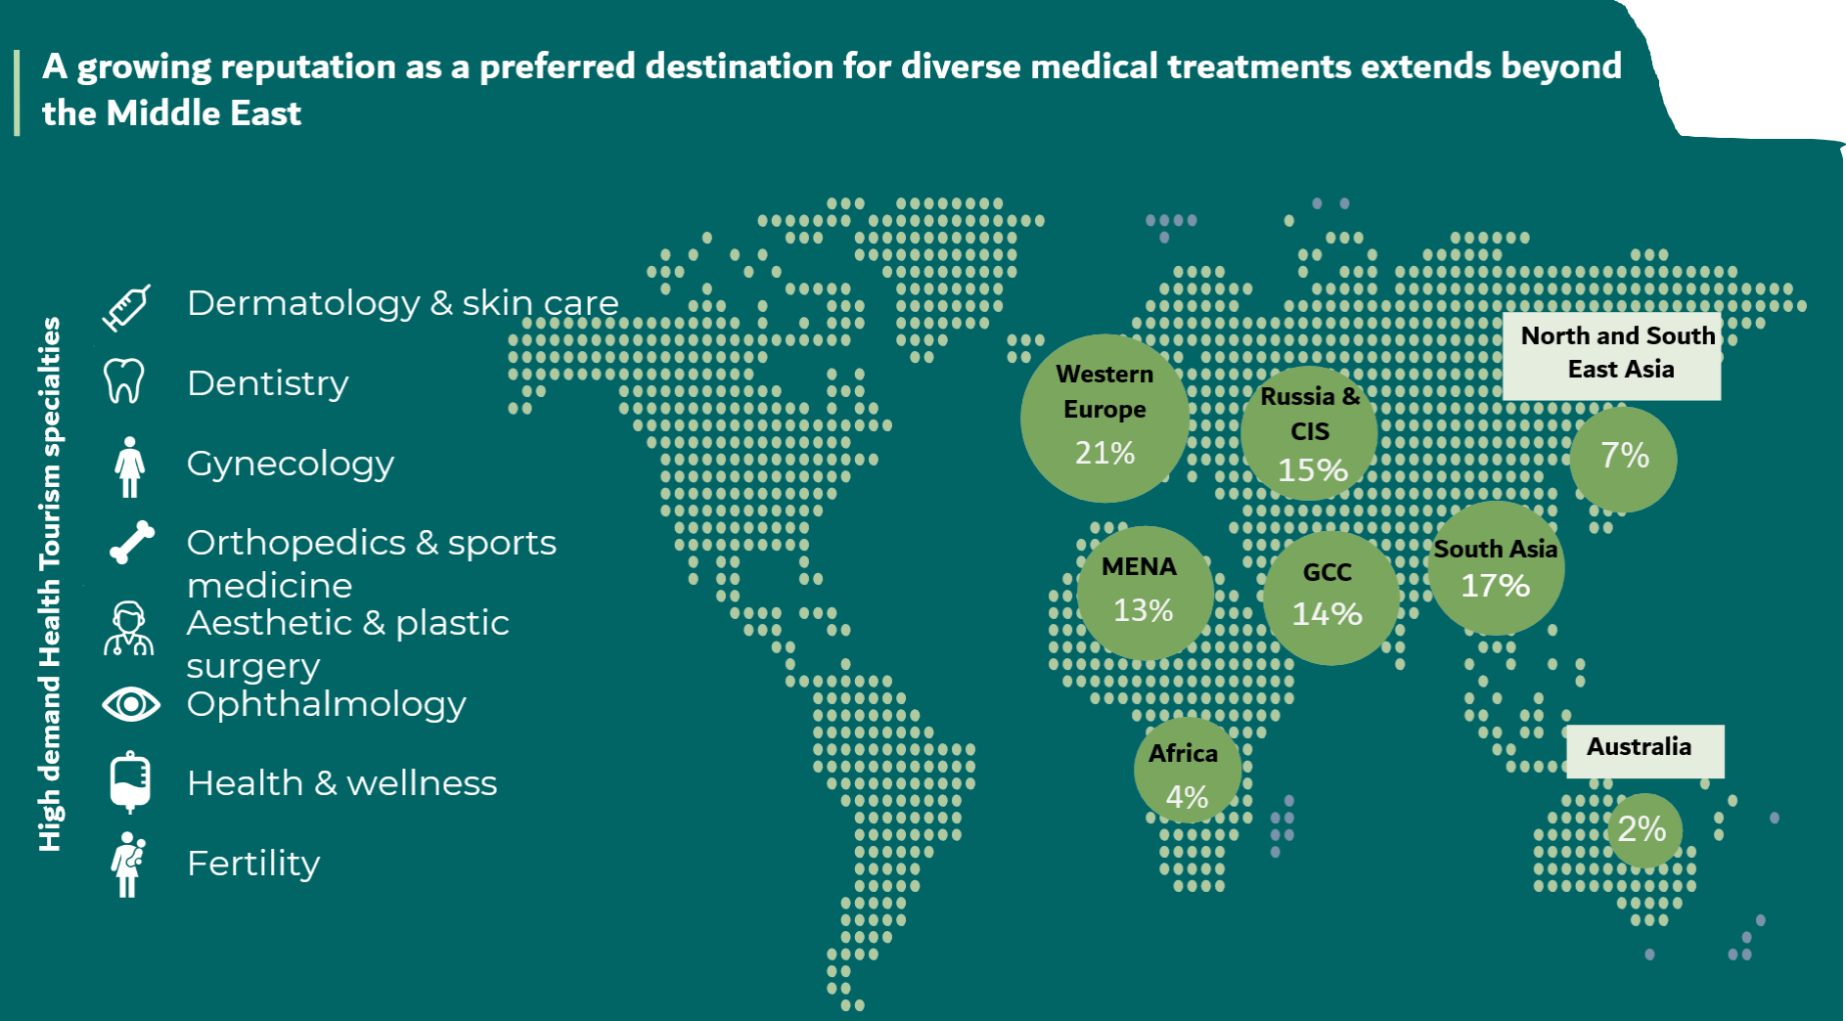

Slide 40
Health
Information
System
04

Slide 41

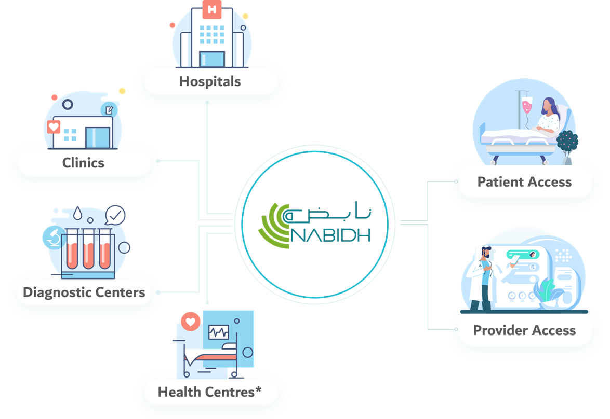
Dubai’s Unified Health Information Exchange and Population Health Program

Slide 42




Facilities
Physicians
Patients
Government
Efficiency
Error reduction
Better Quality of Care
Better Patient Relationship and Engagement
Lowered cost
Preventative Care
Efficiency
Better Decision Making
Access to Information
Improved care
and coordination
Access to single shared record
Better clinical
decision making
Faster
engagement
Easy and
secure access
Safety
Lowered Cost
Time Saving
Better Patient Relationship and Engagement
Improved Care
Improved Patient Safety
Lowered Spending
Preventative Care
Analytics over Population
Better Planning
Better Decision Making
Improved Communication

Slide 43

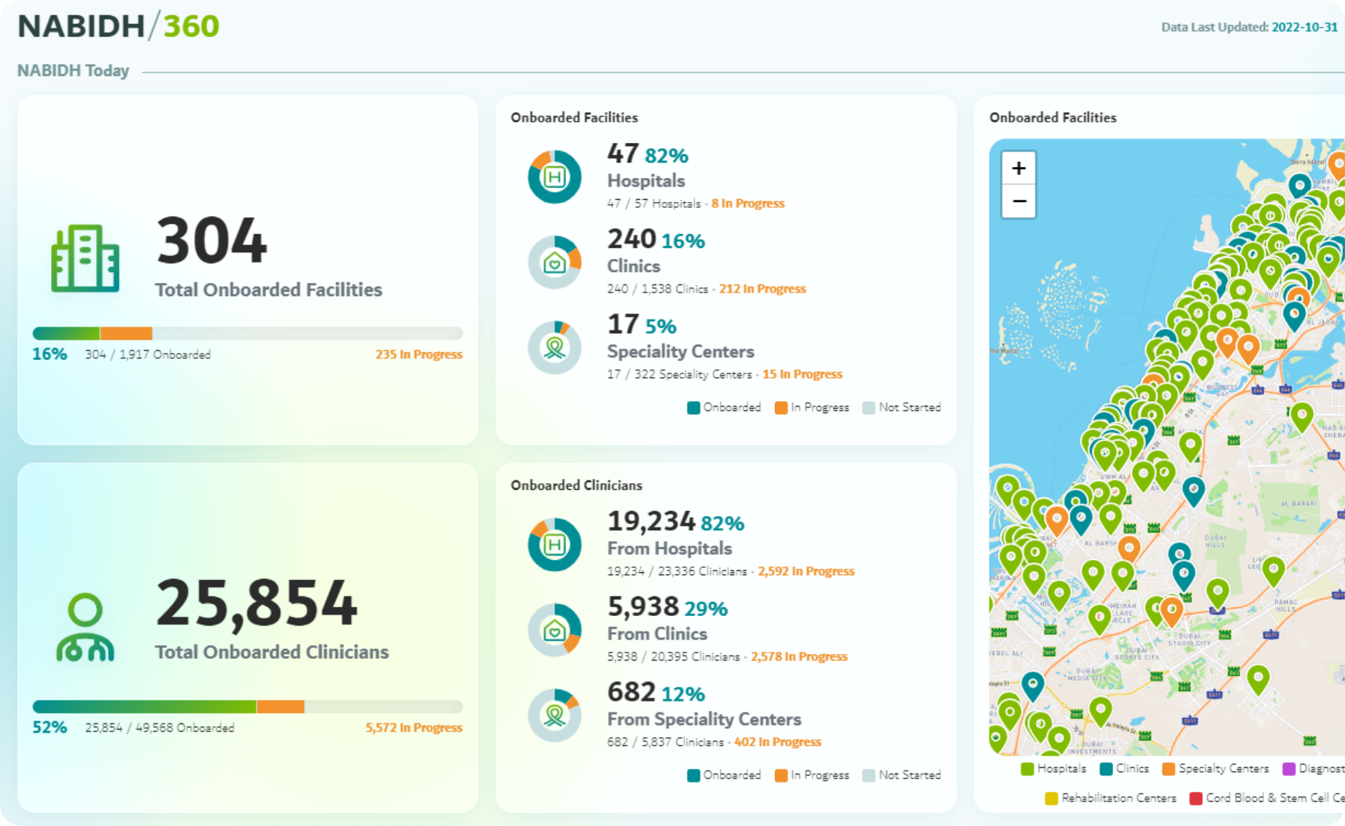
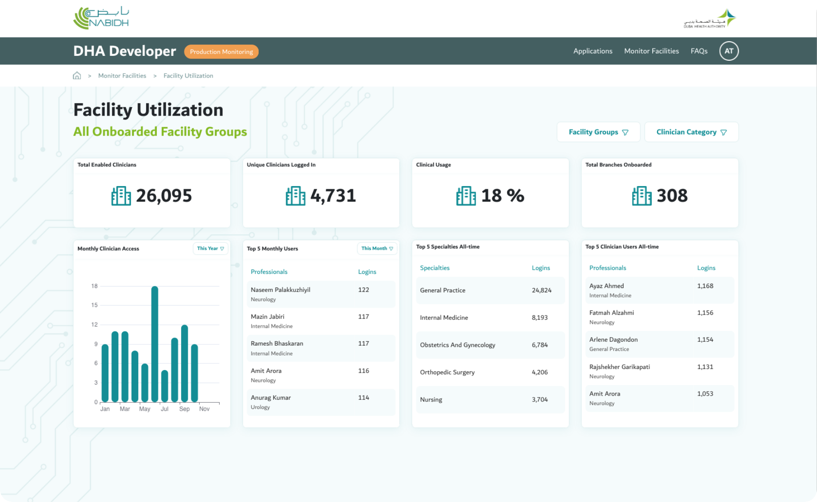
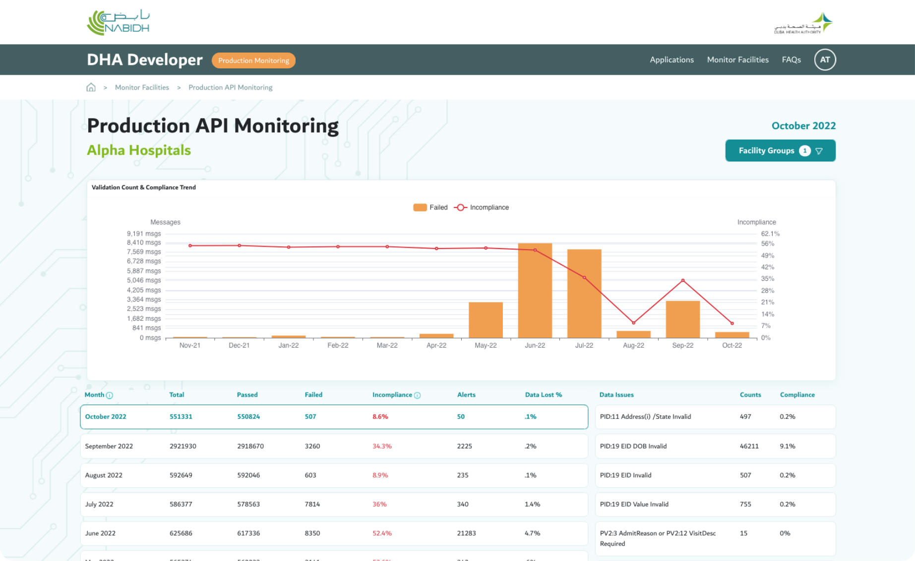

NABIDH Executive Dashboards
OCT 2022
Automated Utilization Dashboard
API Monitoring Dashboard
Executive Dashboard

Slide 44




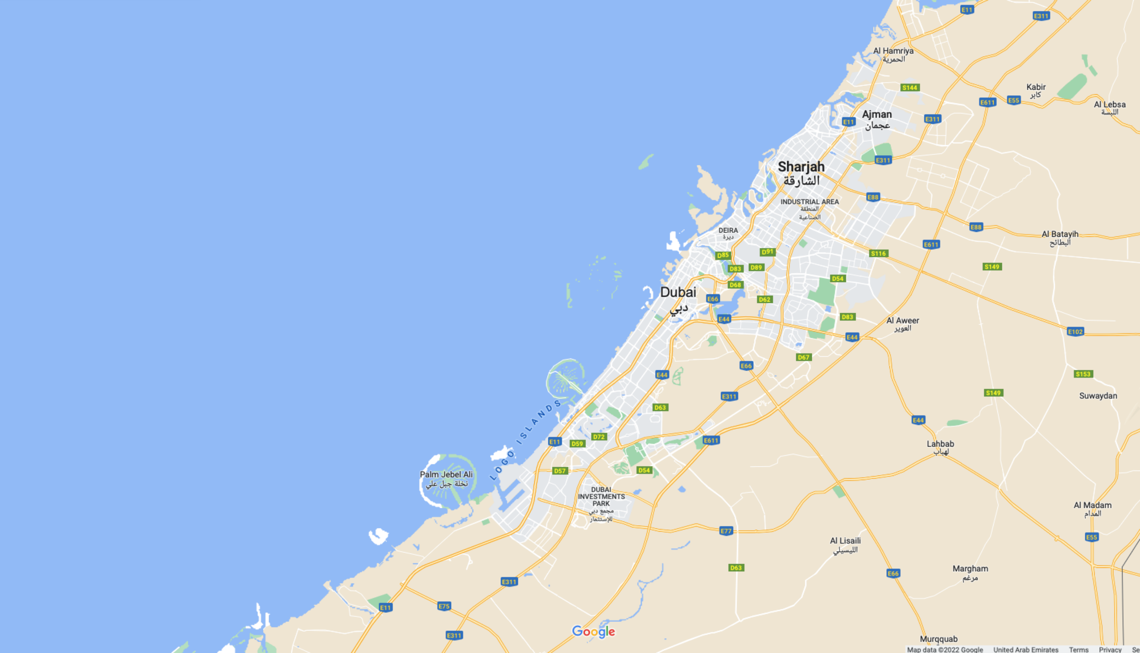






NABIDH in Numbers
58
Hospitals
1378
Clinics
13
Labs

Slide 45

























9.78m
DATA COLLECTED IN MILLIONS
Unified Medical Records
Data as of May 2024 excluding Riayati
237
185
207
114
81
WHO HAS ACCESS?
Observations
Orders
Diagnosis
Medications
Encounters
47,527
1436
76
64
36
9
8.32
10.6
Connected
Clinicians
Onboarded Facilities
Connected
EMRs
Lab Results
Documents
Patients
Vaccinations
Allergies
DATA COLLECTED FROM
5.05
14.4
15.6
6.1
2.7
Social History
Problems
Procedures
Radiology Results
Family History
58
1378
Hospitals
Clinics

Slide 46
Artificial Intelligence in
Healthcare
05

Slide 47
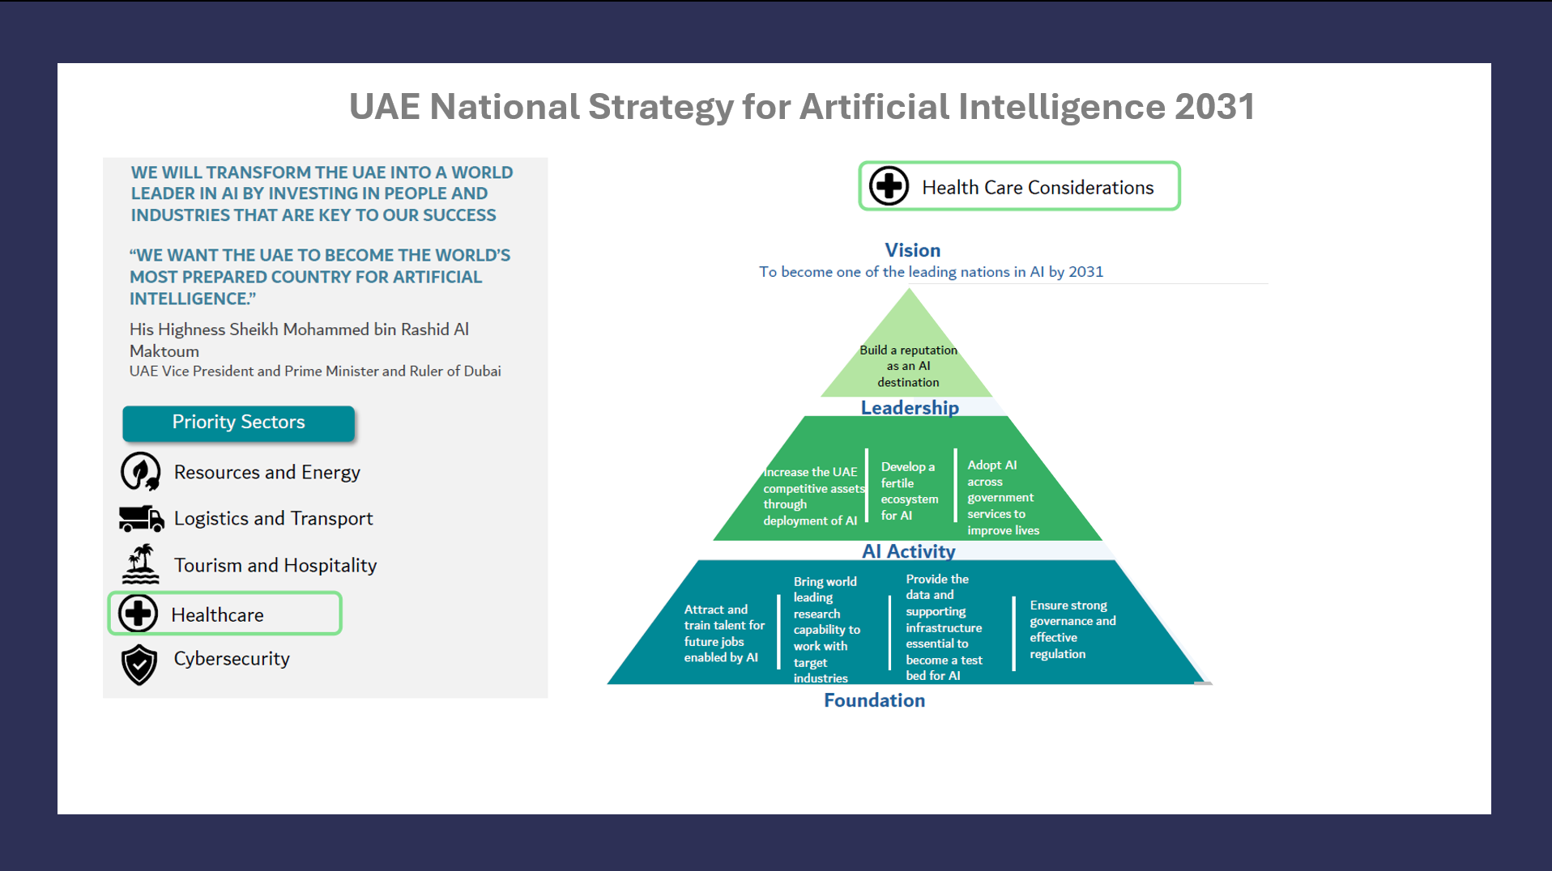

Slide 48

AI Usage considerations
Secure AI infrastructure complying with national data sovereignty laws.
Adherence to mandatory NESA AI standards and Dubai ISR to ensure a strong defense against cyber threats
Encryption & Anonymization: Required by the UAE Data Office to enable safe AI innovation
Dubai Seal: New certification from the Dubai Centre for Artificial Intelligence (DCAI) that verifies companies providing genuine, ethical, and secure AI solutions
Responsible AI development
Upskilling existing professionals

Slide 49
Areas of Focus in Dubai government
Developing AI-Based Cancer Diagnosis
Embedding AI Heart Rate Monitoring
Utilizing AI Diabetes Treatment
Adding AI Dementia Diagnosis
Building AI Voice Recognition
Smart Appointment,
AI-driven diagnostics,
Wearable Health Tech
Patient Flow Management
Precision Medicine

Slide 50
Areas of focus in the private sector
Improving accuracy in detecting diseases
AI-Driven Medical Imaging
Enhancing remote consultations and patient monitoring
Streamlining healthcare accessibility
AI in Telemedicine
Improving precision and recovery times
Enhancing financial operations
AI is automating hospital management

Slide 51
Areas of focus in
Abu Dhabi
Department of Health announced an AI-powered Population Health Intelligence Framework at the 2025 Abu Dhabi Global Health Week.
• Goal: Improve public health through predictive insights and proactive interventions.
• Two Core Pillars:
Predict: Create a digital twin of Abu Dhabi to detect health anomalies using integrated data and AI.
Prevent and Act: Deliver AI-driven, context-aware recommendations and simulate intervention outcomes for timely response.

Slide 52
Areas of focus at a federal level
Building smart and analytical dashboards
Developing predictive models to support decision-making
Utilizing artificial intelligence to automate routine processes
Developing interactive tools such as chatbots
• Health Crisis Management Smart Dashboard
• Smart Predictive Model for Births, Deaths, and Morbidity
• "Hayat" Organ Donation System: AI-enhanced tracking to
improve transparency and save lives
• Fraud Detection ("Wafed"): AI solutions to identify forged
health certificates and ensure workforce integrity

Slide 53
Future Shaping and Investments
06

Slide 54
Ownership of project
Partnership with existing facilities
Take over existing facilities
100% Foreign Ownership
100% seamless online licensing process:
  1 week to issue facility license
  1 day to issue professional license

Slide 55
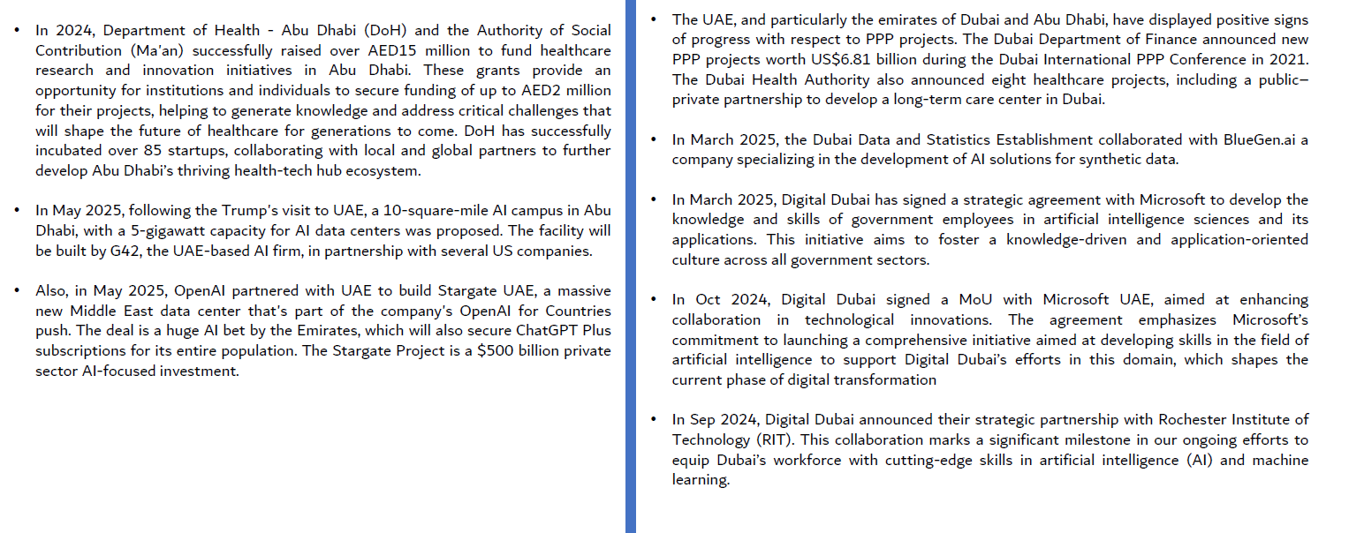
Headlines

Slide 56
AI Driven Healthcare System
Proactive to Predictive Care
Tools that enhances rather than replaces physicians
Precision medicine and hyper personalized treatments using genomics.
Healthcare shifts to :
Hospitals at home
Value base clinics
AI hospitals
Remote clinics
Gene Therapy

Slide 57

Let's Connect

Slide 58
Panel discussion: Unlocking New Horizons: Business and Collaboration between the New Nordics and Gulf region
Moderator: Ain AAVIKSOO, Head of Development | Partner at Heba, Senior Business Advisor at Nortal
Panellists:
  Dr Khulood ALSAYEGH, Senior Healthcare Leader | AI & Precision Medicine Pioneer | Head of Clinical Standards & Guidelines, Dubai Health Authority
  Taavi EINASTE, CEO MEA and Partner | Nortal
  Walid KATTAN, Regional Director | BeeHealthy
  Piret SAUTER, Regional Director of Distant Export Markets | Estonian Business and Innovation Agency

Slide 59
13:15 – 14:15
Lunch

Slide 60
Keynote presentation: "The AI Act - how medical device manufacturers and healthcare organisations are affected"
Leo Doorn
CEO and Co-Founder | MedQAIR

Slide 61
AI Act
The implications of the AI Act on Medical Device Industry (manufacturers & healthcare)
L.J. Doorn, M.Sc.
Enterprise Estonia
Founder MedQAIR

Slide 62
AI Act Development
First draft published - April 2021
Major revision to include General Purpose AI – March 2022
Parliament agreement on the AI Act – December 2023
European Council adopts AI Act – May 2024
Publication in the European Official Journal – July 2024

Slide 63
AI Act Development
AI Act entry into force – August 1 2024
AI Act Literacy requirements apply – February 2 2025
Prohibitions on AI enter into effect – May 2 2025
GPAI models compliance (new models) & penalties – August 2 2025
Ultimate Post-Market Surveillance Plan publication data EC – August 2 2026
Application to High-Risk AI systems (Annex III) – August 2 2026
Application to High-Risk AI systems – August 2 2027

Slide 64

AI literacy
Article 4
AI literacy Providers and deployers of AI systems shall take measures to ensure, to their best extent, a sufficient level of AI literacy of their staff and other persons dealing with the operation and use of AI systems on their behalf, taking into account their technical knowledge, experience, education and training and the context the AI systems are to be used in, and considering the persons or groups of persons on whom the AI systems are to be used.

Slide 65
Provider role
Article 3 (4)
For medical devices enabled by AI/ML, the provider role is nearly synonymous to the term medical device manufacturer
‘provider’ means a natural or legal person, public authority, agency or other body that develops an AI system or a general-purpose AI model or that has an AI system or a general-purpose AI model developed and places it on the market or puts the AI system into service under its own name or trademark, whether for payment or free of charge;

Slide 66
Deployer role
Article 3(4)
‘deployer’ means a natural or legal person, public authority, agency or other body using an AI system under its authority except where the AI system is used in the course of a personal non-professional activity;
For medical devices enabled by AI/ML used by physicians in the context of medicine, could also imply the physician being a ‘deployer’
Healthcare institutions purchasing and implementing AI/ML-enabled medical devices are considered ‘manufacturers’

Slide 67
Risk classification AI systems
Prohibited AI Systems (article 5) – e.g. subliminal techniques, exploitation
High-Risk AI Systems (article 6) – e.g. healthcare staff prioritization (annex III), medical devices (annex I)
General-Purpose AI models (article 53) – e.g. non-systemic risk
General-Purpose AI models (article 55) – e.g. systemic risk
General-Purpose AI systems & low-risk AI (article 50) – All other

Slide 68
Healthcare organizations
Organizational
Implementation of technical and organizational measures to ensure use of AI in line their instructions
Assign the required level of human oversight
Select, inform and train staff members on the use of the AI (note: AI literacy)
Execute FRIA for Annex III AI systems
Technical
Ensure relevant and representative input data
Monitor AI system operation
Storage of automatically generated logs (> 6 months)

Slide 69
Manufacturers
(AI/ML- enabled medical devices)
Quality Management
Data Management procedures
Fundamental Rights risk assessments
Fundamental Rights reporting obligations
Predetermined changes
Resource management
Additional QMS standard(s) (?)
Technical Documentation
Detailed data descriptions and assessments
Post-market Monitoring
Detailed AI descriptions
Fundamental Rights risk assessment
Predetermined changes
Additional technical standard(s) (?)
Conformity Assessment
Declaration of Conformity (against AI Act & GDPR)
Access to datasets for Notified Bodies and governments
Notified Body re-testing of the AI system (as requested)
AI Expert reviews

Slide 70
Challenges
Timelines are short, e.g. 1 year has passed, 2 years pending, to date no ‘accredited’ Notified Bodies
Standards are running behind, to date no harmonised standards available for Quality Management Systems, Risk Management, Data Management, Trustworthiness, etc
No grandfathering (e.g. prior approved Medical Devices enabled by AI/ML will need to undergo re-approval prior to August 2027)
Limited guidance documentation available to prepare for the deadline
Dataset requirements under the AI Act are high, prior developed AI/ML-enabled medical devices may not be compliant (e.g. datasets may not be available in their original configuration), and overall data availability is not yet governed (e.g. through the EHDS)

Slide 71
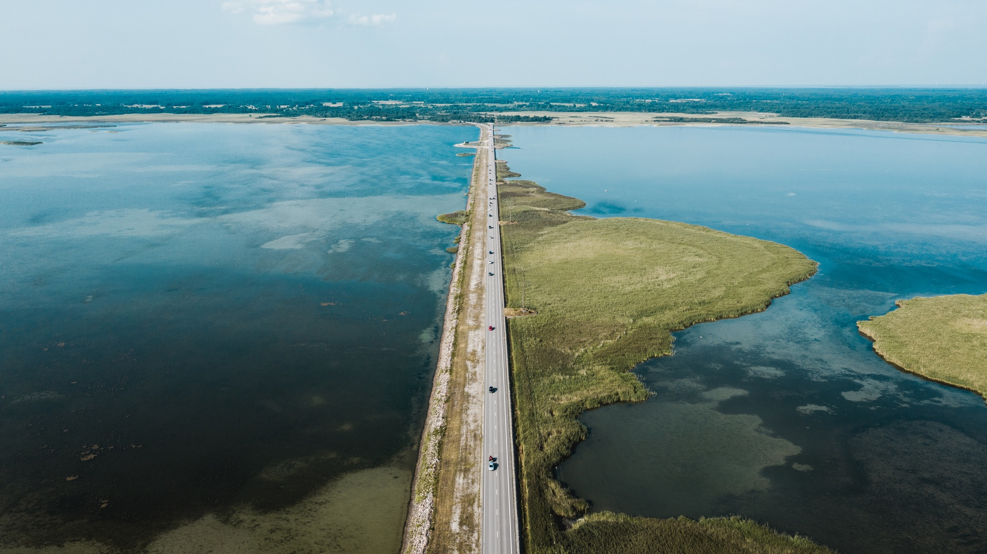

Thank you!
Author
Enterprise Estonia
eis.ee

Slide 72
Panel discussion: The European Health Data Space: Still a Dream or Reality?
Moderator: Elina DRAKVIK, Senior Lead | Sitra, Finnish Innovation Fund | TEHDAS2 Joint Action
Panellists:
  Jaanika MERILO, Head of Digital Health and Care | Estonian Ministry of Social Affairs
  Michel SILVESTRI, Head of Unit, Coordination Department | Swedish eHealth Agency
  Leon DOORN, CEO & Co-Founder | MedQAIR
  Rutt LINDSTRÖM, Data Standardisation Expert | TEHIK | HL7 Europe
  Lenne-Triin KÕRGVEE, Director | Tartu University Hospital, Cancer Centre / Pediatric Oncologist-Haematologist

Slide 73
15:30 – 16:00
Coffee Break

Slide 74
Inspirational keynote speech:
"No one yet knows just how good the future will be"
Elizabeth Jennings
Managing Partner | Venture Atlas Labs

Slide 75

No one knows how good the future will be
Elizabeth Jennings | Managing Partner, Venture Atlas Labs

Slide 76
Innovation is often driven by personal experience.

Slide 77
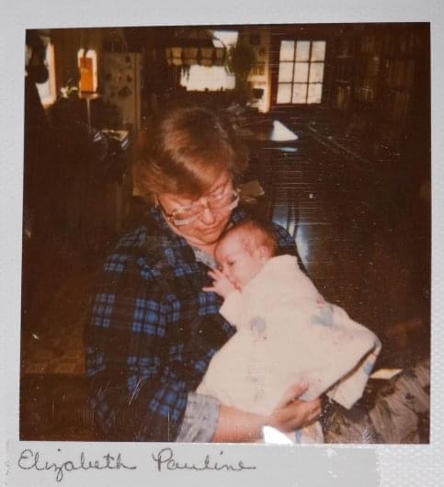

Slide 78
We are in a hard business because it is hard.

Slide 79
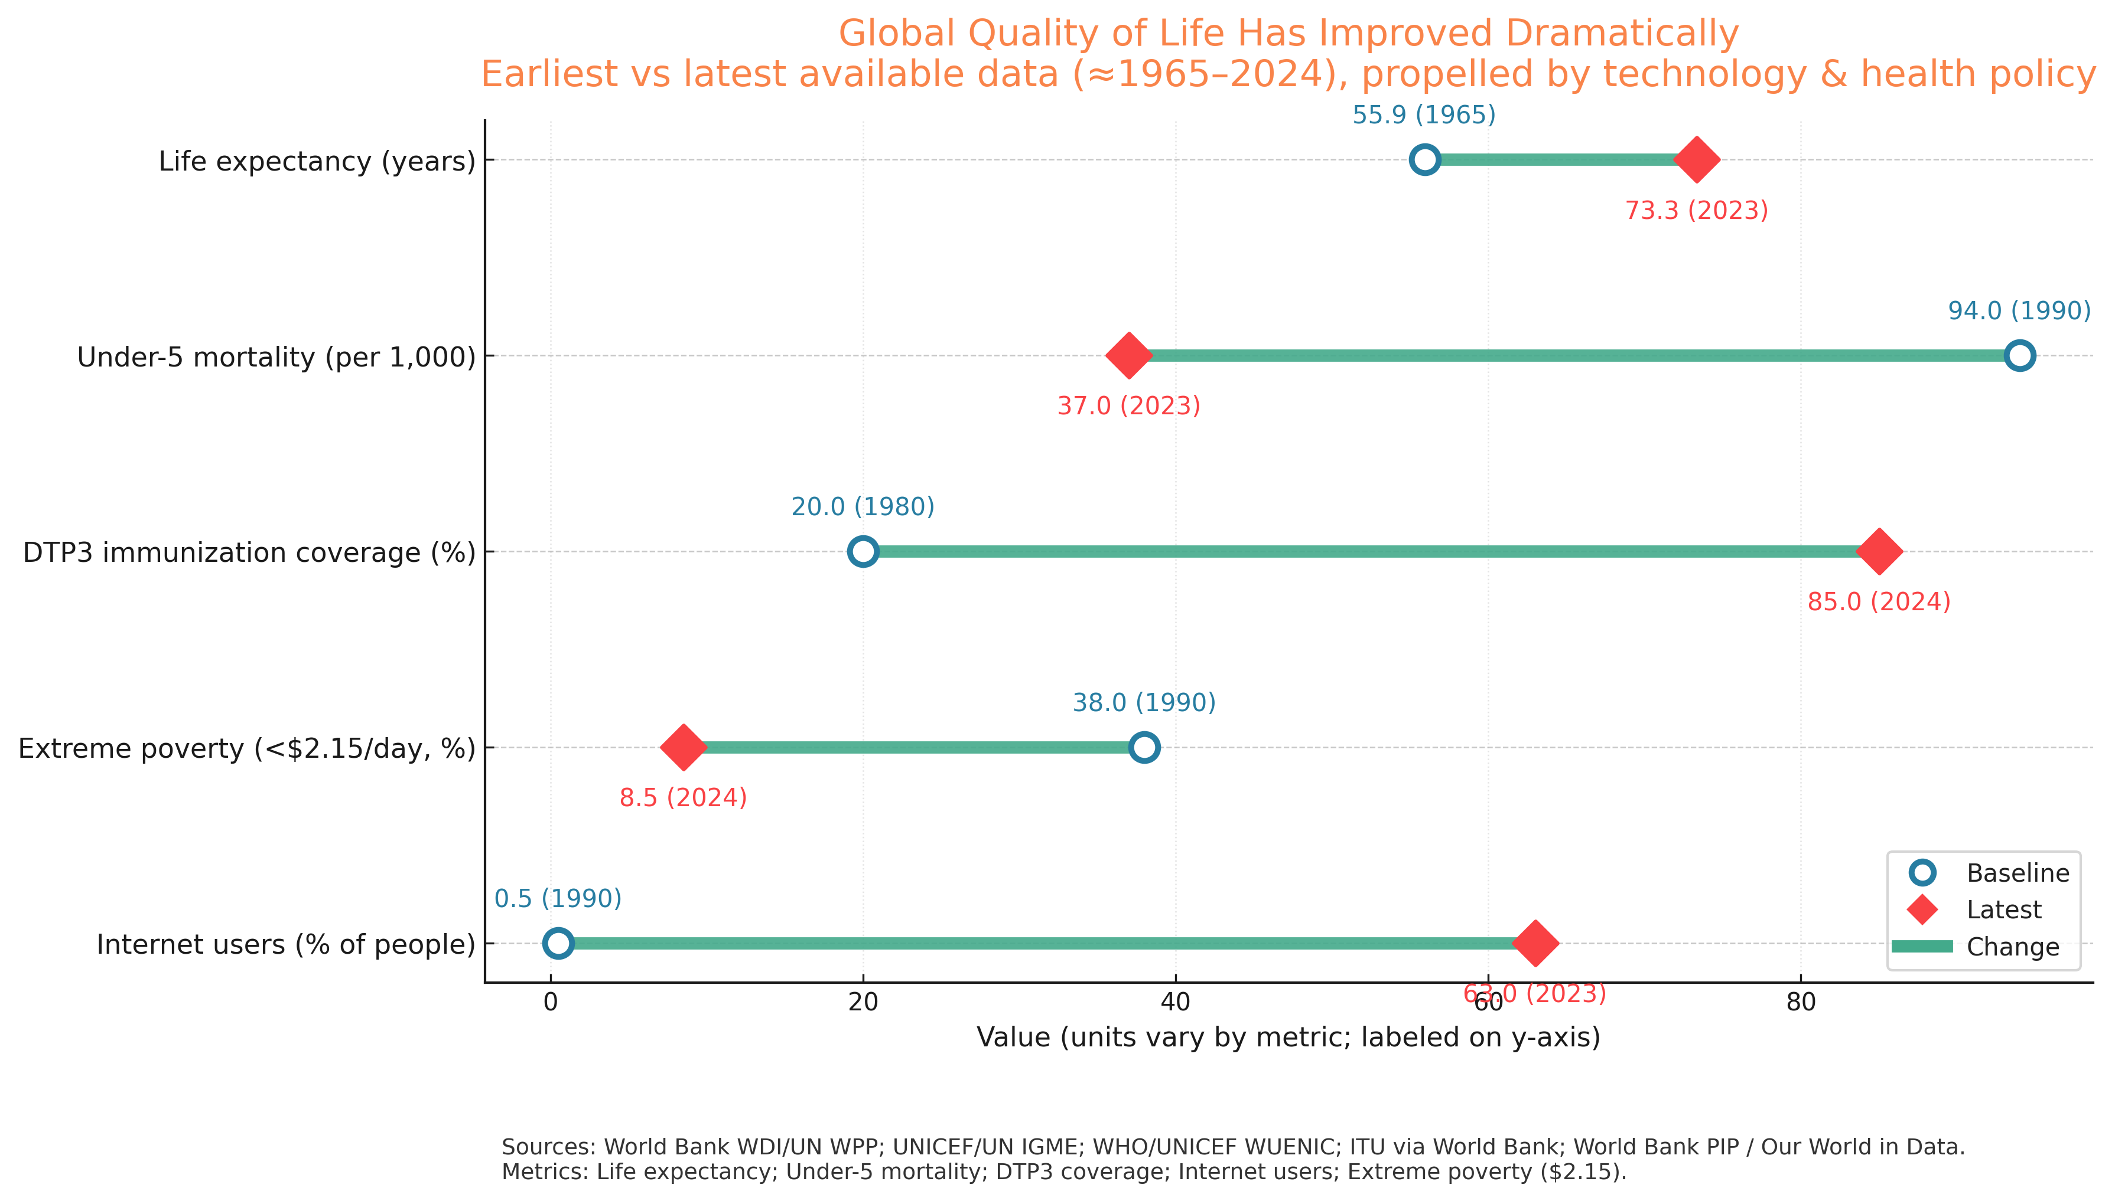
But things are actually getting better
We live longer, and with longer healthspans, than ever before.

Slide 80
We can do hard things, even amid uncertainty.

Slide 81



So many innovations change lives which creates an impact we often never see or know
$10.5M raised

Slide 82

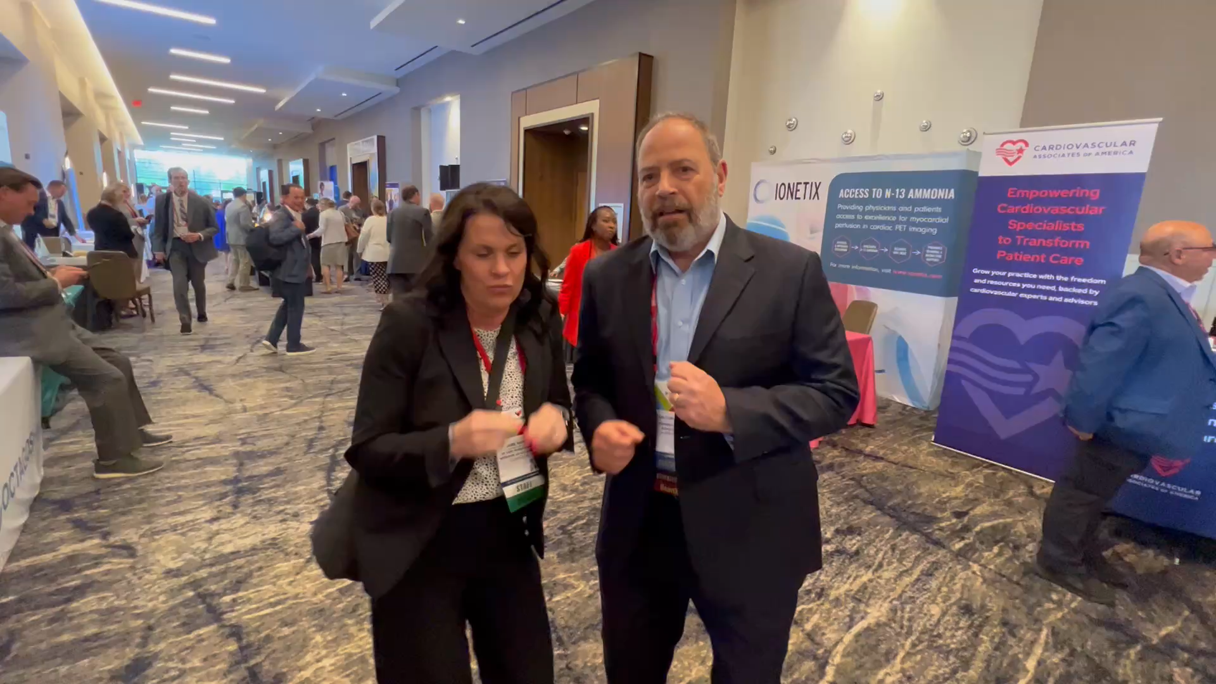


Slide 83
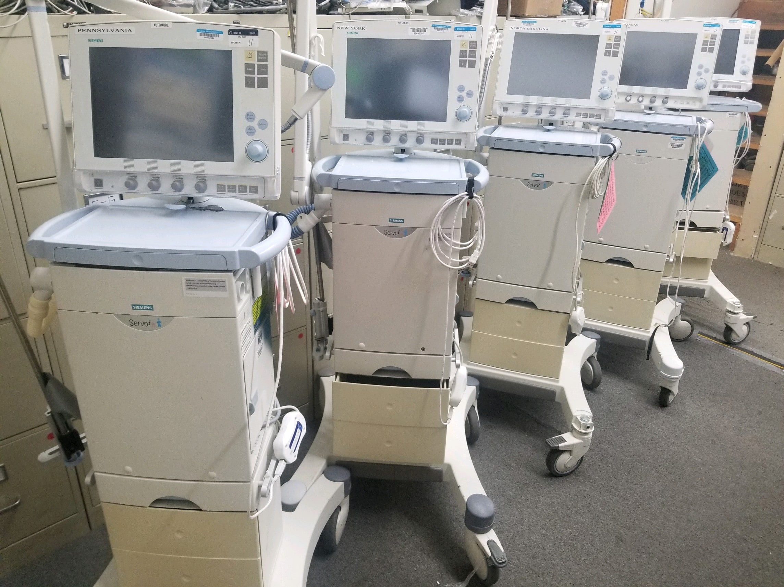

Slide 84
Healthcare is nuanced and full of uncertainty.

Slide 85
We will persist to improve the lives of people we will never meet.

Slide 86
The champions we’re waiting for are in this room, are you and I.

Slide 87
Run through the tape.

Slide 88

Q&A
Elizabeth Jennings
Managing Partner,
Principal
Venture Atlas Labs, Austin
Direct: +1 325 200 9266
E-mail: Elizabeth@ventureatlaslabs.com

Slide 89
Panel discussion: Best practices in health innovation based on the examples of Singapore and Australia
Moderator: Elizabeth JENNINGS, Managing Partner | Venture Atlas Labs
Panellists:
  Smitha Velayil SUNILDEEP, Innovation & Enterprise Manager | National Health Innovation Centre, Singapore (NHIC)
  Melissa POLLARD, Executive Manager, Digital Health & Technology | Hunter New England and Central Coast PHN, Australia

Slide 90
Key takeaways of the day and Closing Remarks

Slide 91

THANK YOU AND PLEASE SHARE YOUR FEEDBACK!
www.dtxnewnordics.com

