Slide 1
Pitching
my observations
Vaido Mikheim
Startup Estonia

Slide 2
Super short summary
How to pitch?
Be comfortable
Be convincing
Be confident

Slide 3
Why are we here – short summary
Be authentic (be You)
Be comfortable Be prepared
Be ready for failure AND success
Be clear
Be convincing Have a plan
Be fresh mentally and physically
Be confident Trust (your team / solution)
Accept (surprises and learnings)

Slide 4
An elevator pitch, is a short description of an idea, product, or company that explains the concept in a way such that any listener can understand it in a short period of time.
https://en.wikipedia.org/wiki/Elevator_pitch

Slide 5
Trap no 1
We act against our nature.
And that is tough to pull off.

Slide 6
Be prepared: structure and key components of your story
Problem or unused opportunity
Validation of the problem or solution
Solution
Human dimension of the solution
Team
What do we know and what we can do
Roadmap and timeline
What we have done so far and what we are going to do
Call to action
What the audience can do for You?

Slide 7
1
Key takeaway
What is The One Thing you want me to remember?

Slide 8
What problem are you solving?

Slide 9
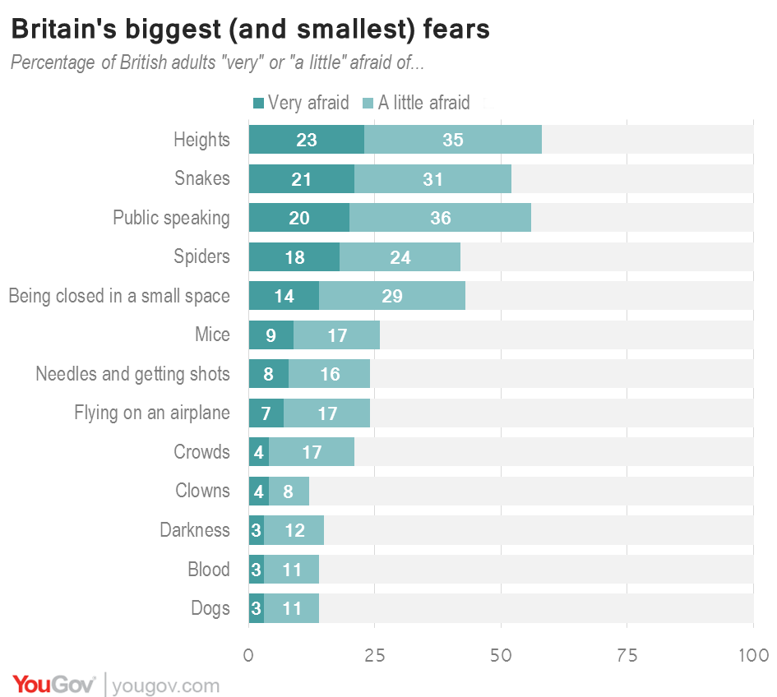
Validate the problem

Slide 10
What is the human dimension?

Slide 11
Time won?
Money saved?
Happy people?
Better reputation?

Slide 12
Trap no 2
We do not create relatable connections!
Will the listener without your know-how understand you?

Slide 13
What is a value proposition?
A value proposition is a simple statement that summarizes why a customer would choose your product or service.

Slide 14
Steve Blank formula
We help (X) do (Y) by doing (Z).
“I help marketing teams to resonate with their target audiences by communicating with clarity and compassion.”
“We help our local customers to feel good and do good by fueling them up with artisanal coffee in a community-focused space.”

Slide 15
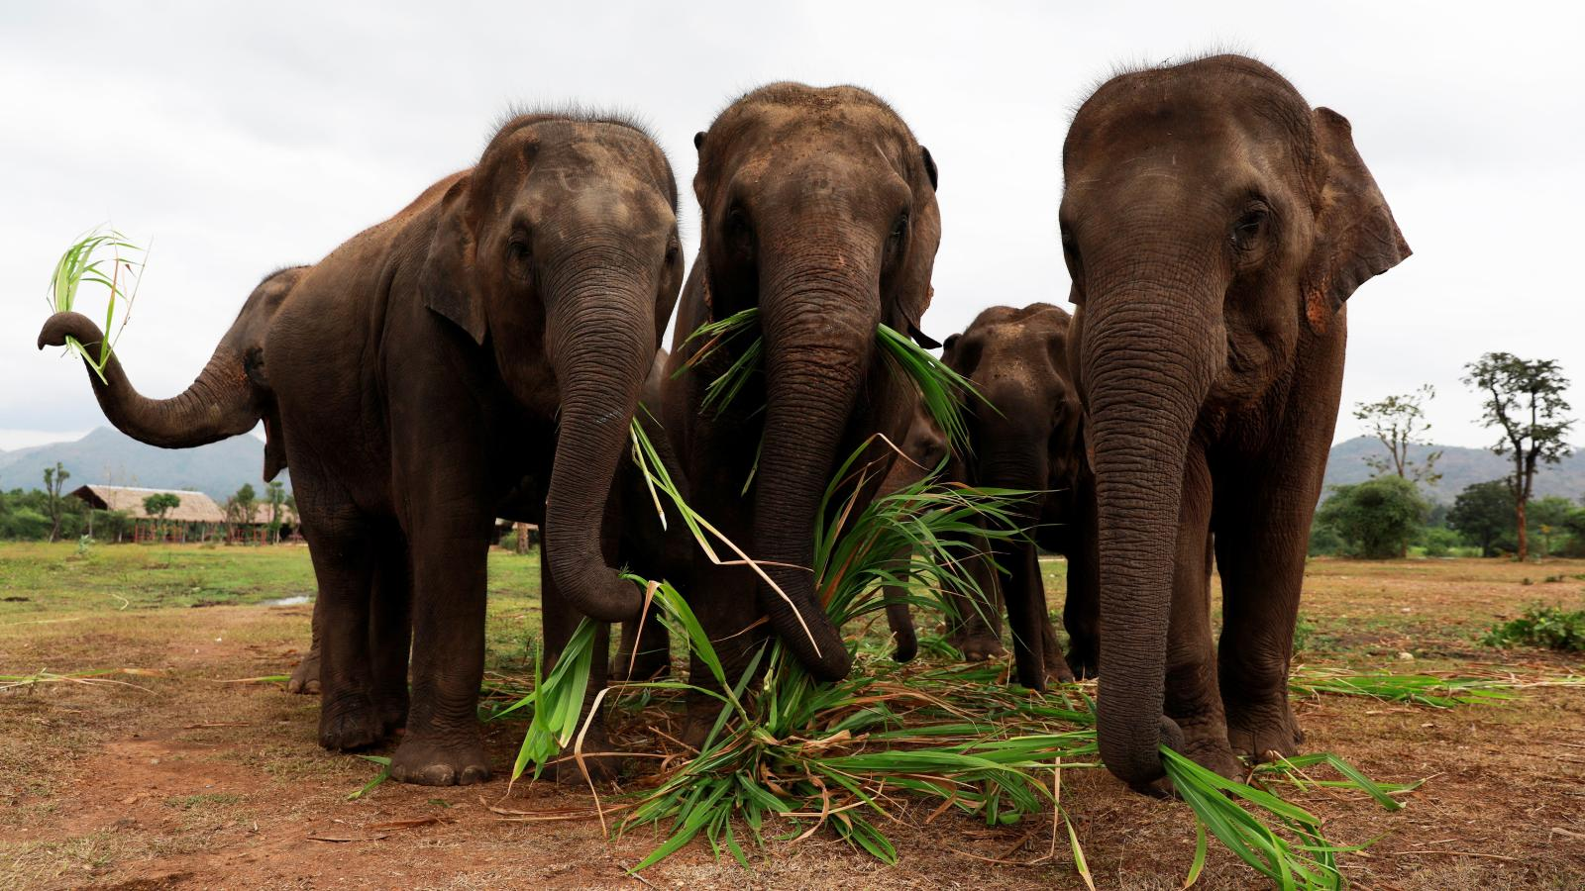
Elephants

Slide 16
First 20* seconds win attention
* Paul Hellman “You’ve got 8 seconds”

Slide 17
Solution / competition
T
R
A
P
5

Slide 18
CREDIBILITY
aka
give me reasons to trust You

Slide 19
ROADMAP
What have you done so far?
What are we going to do from now on?
What stages we need to go through?

Slide 20
LESS
IS
MORE

Slide 21
LESS IS MORE
How many words can you fit into minute?
130-140 words
=
9 sentences

Slide 22
Solution f*ckups
Wait, what is it that you really do?
For whom is it useful?
Do not get stuck into technical details*

Slide 23
Summary / closing
Why do you care?
Why should I care?
Call to action
How can I help?
Takeaway message
What do you want me to remember?

Slide 24
Questions that are usually helpful before
you take the stage

Slide 25
WHO
WHY
WHAT

Slide 26
WHO is our audience?
WHY are we talking?
WHAT should we say?

Slide 27
AUDIENCE
How many – can we talk to them all?
What type – pragmatic, old school, doers, academic?
What do they care about – technology, business, impact, people?
What are their biggest objections?

Slide 28
Objections
Why hasn’t it been done already?
Market is full of competing solutions?
I don’t believe your team can cut it!
Your action plan is full of (black) holes !
I don’t have time for this!

Slide 29
Goal
What do you want the audience to do?
call to ACTION

Slide 30
SUMMARY
We spoke today…
One sentence summary.
We kindly ask you to…
Remind call to action
I / we believe this matters because…

Slide 31
Feedback / Final Boss trap

Slide 32
SHORT and CONCISE answers
(but not „ok“)

Slide 33
Thanks!
*bonus tip: sleep well
vaido.mikheim@startupestonia.ee

