Slide 1
Enhancing innovation in hospitals
Jaarika Järviste
Estonian Health Insurance Fund
Head of Development
14.10.2022

Slide 2
What will I talk about?
Biggest innovative collaboration projects
How collabortion has changed in last 4-5 years?
Supporting mechanisms for innovation
Notes:
EHIF has now for over 4 years been working with different health care providers on numerous innovation projects.
With every project we learn something new and it will be interesting to look at how the challenges in collaboration have changed in the past years.
I will be sharing the mechanisms EHIF has for supporting innovation in hospitals.

Slide 3
Biggest innovative collaboration projects

Slide 4
EHIF-hospitals collaboration projects
Stroke care pathway
2019-2022
Remote monitoring pilot projects
2020-2023
Hip and knee replacement care pathway
2021-…
Notes:
That is in addition to single service developments (video consultations, eConsultations etc)

Slide 5
Notes:
https://www.youtube.com/watch?v=Uji7sYUKJxw&t=1s

Slide 6
Notes:
https://www.youtube.com/watch?v=yppy8NdmsFk&t=1s

Slide 7
15.11.2021

Slide 8
Providers, researchers, vendors and payer work for the same goal
Reaching agreements on…
Service ownership
Quality measures
Research methodology
Service price
Performance pay
…in less than a year
Common goal, equal partners
Notes:
…and that has enabled us …

Slide 10
How collaboration has changed in last 5 years?

Slide 11
Mindset shift
EHIF says and hospitals do
Freedom to decide what to do was confusing for hospitals
EHIF creates opportunities
Shared responsibilities
Equal partners

Slide 12
Other insights
Innovation drivers in hospitals are emerging but there is not enough
Experience sharing between the hospitals would take us further faster
Tartu University Hospital’s innovation fund
North Estonian Medical Centre collected patient pathways ideas
Pärnu Hospital maps patient journeys
Etc
The problems and solutions stand far from eachother
Notes:
, but hospitals are struggeling finding Resources to keep these people

Slide 13
“Coming together is a beginning, staying together is progress, and working together is success.”
Henry Ford

Slide 14
EHIF support mechanisms for innovation

Slide 15
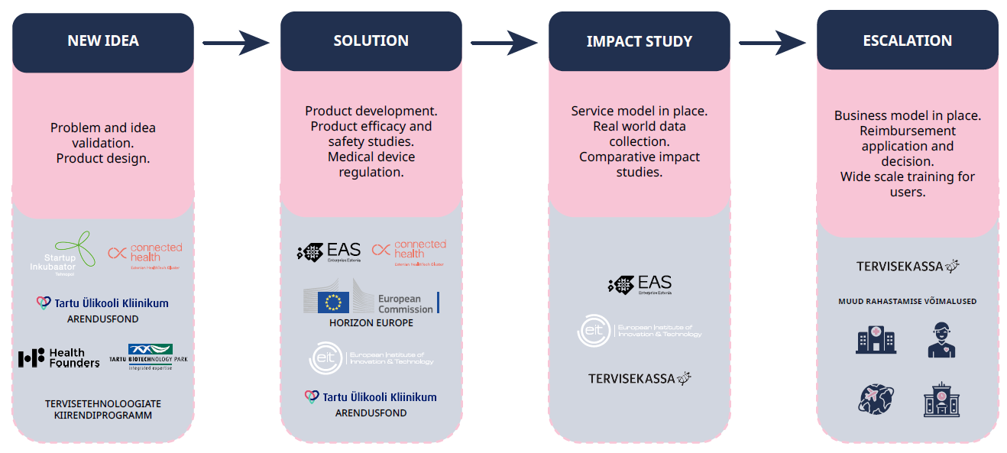
Innovation stages and support mechanisms

Slide 16
Innovation stages and support mechanisms

Slide 17
EHIF innovation fund invests 3 mln € a year for collaborative impact assessment projects
Investment in good quality evidence about innovative services compared to best practice so far.
Not investing in product development.

Slide 18
You’re welcome to EHIF inspiration day on 4th of November in Tallinn!
We’ll focus more on health innovation support mechanisms
We’ll spread the word through Biopark

Slide 19
Collaboration is key in getting innovation in use!
Thanks!
Notes:
Tervisekassas töötame selle nimel, et head lahendused sünniksid kiiremini ja kasutajale lähemal
Kõigil saalisviibijatel on üks eesmärk, et Eesti inimene elaks kauem tervena. Töötame selle nimel koos!

