Slide 1
I
Euroopa Terviseandmete Ruum
www.scanbalt.org
10. Juuni 2022
DR JAANUS PIKANI (Chairman of ScanBalt)

Slide 3
2016
2017
2018
2019
2020
2021
2022
2023
2016 - General Data Protection Regulation (GDPR)
2018 – Regulation on the free flow of non personal data
2018 - Digital Health Strategy
2019 - Open Data Directive
2019 - Cybersecurity Act
GDPR enters in force May 2018
2020 - Data Strategy
2020 - Data Governance Act (DGA)
2021 – 2030 Digital Compass
2021 - Artificial Intelligence Act
2021 - Digital Services Act
European Union
Data related measures
2021 - Digital Markets Act
2021 - Data Act
2022 – Chips Act
2022 – EHDS
Source and aknowledgement Markus Kalliola, SITRA
27.10.2021/22.3.2022

Slide 4
European Strategy for Data (2020)
A common European data space, a single market for data
Data can flow within the EU and across sectors
Availability of high-quality data to create and innovate
European rules and values are fully respected
Rules for access and use of data are fair, practical and clear & clear data governance mechanisms are in place
Source and aknowledgement Markus Kalliola, SITRA

Slide 5
The European Health Data Space is a health specific ecosystem comprised of rules, common standards and practices, infrastructures and a governance framework
EHDS Proposal published 03/05/2022
Source and aknowledgement Markus Kalliola, SITRA

Slide 6
Source and aknowledgement Markus Kalliola, SITRA

Slide 7
Four pillars of the European Health Data Space
LEGAL & GOVERNANCE
DATA
QUALITY
INFRA-STRUCTURE
CAPACITY BUILDING
PRIMARY
use of health data
BETTER HEALTHCARE
BETTER POLICY-MAKING
SECONDARY
use of health data
BETTER RESEARCH & INNOVATION
Source and aknowledgement Markus Kalliola, SITRA
Notes:
Heitä TEHDAS Junan alle

Slide 8
The needs, expectations and views of stakeholders on economic sustainability
Options for governance models for data-sharing at EU level, in particular networking for secondary use
Sustainability
Governance
Secondary use of health data
Availability of comparable high-quality health data for research and innovation
Definitions, good practices and use cases of GDPR-compliant data altruism
Data altruism
Data quality
Citizen
engagement
Shared European data infrastructures across the EU (cf. eHDSI)
Citizen perception of health data and data-sharing practices
Infrastructure
Source and aknowledgement Markus Kalliola, SITRA

Slide 9
Barriers on cross-border sharing of health data for secondary use and options to overcome these
47 papers reviewed by 4 reviewers to identify barriers
from 89 barriers 20 went through detailed analysis and 11 barriers were prioritized
23 European countries provided 113 case studies to give real-life examples of the 11 barriers on impact, issues and solution
6 were legal
3 were data/semantic related
1 infrastructure
1 trust
Source and aknowledgement Markus Kalliola, SITRA

Slide 10
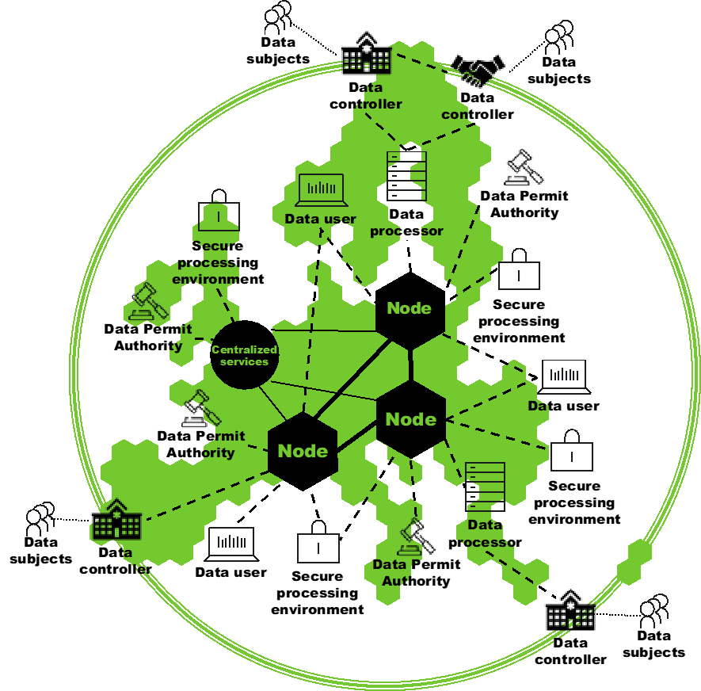
Overall architecture
Source and aknowledgement Markus Kalliola, SITRA

Slide 11
TEHDAS Stakeholder Forum 14 June 2022 in Helsinki
www.tehdas.eu
Side event of HIMSS European Health Conference 14-16 June 2022

Slide 12
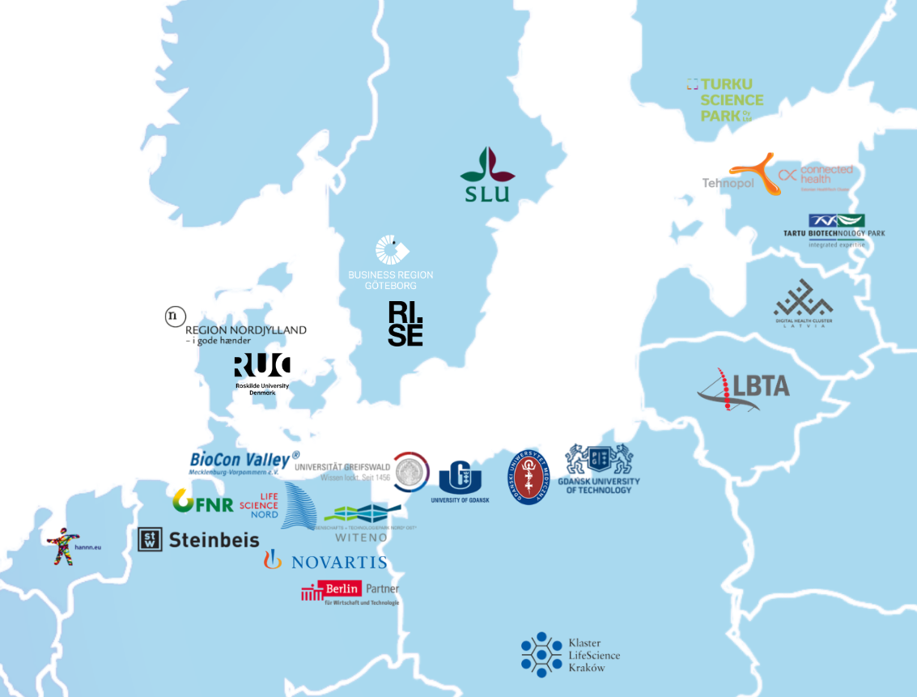
ScanBalt
24 members from Germany, Sweden, Denmark, Finland, Estonia, Latvia, Lithuania, Poland and the Netherlands.
A Global
Hot Spot for Health and Bioeconomy

Slide 13
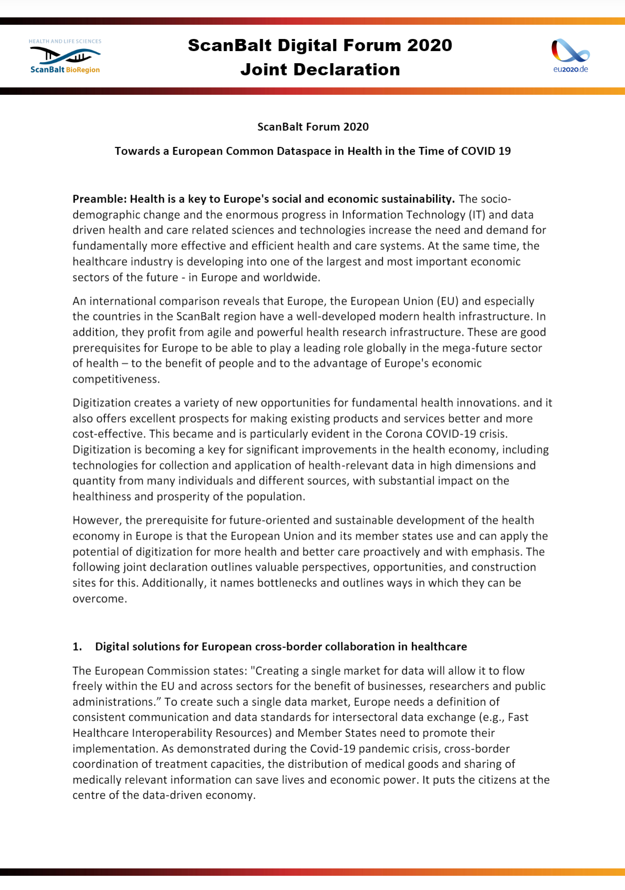
Joint Declaration: towards a European Common Health Data Space
The Joint Declaration describes the current situation, points to bottlenecks and offers possible solutions for the creation of a common European data space.
It has been submitted to the German EU Council Presidency as the voice of the civil society on the topic.
EU-Trio partners Portugal and Slovenia can pick up initiative and re-mobilize cluster community
Contributing states

Slide 14
EHDS
Patient centricity and data protection
Primary and secondary data
Institutionalisation of a European Digital and Health Data Board
Wellness data as more than a “nice-to-have” addon
Use and misuse of data
Semantic and technical interoperability

Slide 15
EHDS conference under Swedish EU presidency
Vitalis
May 23-25, 2023

Slide 16
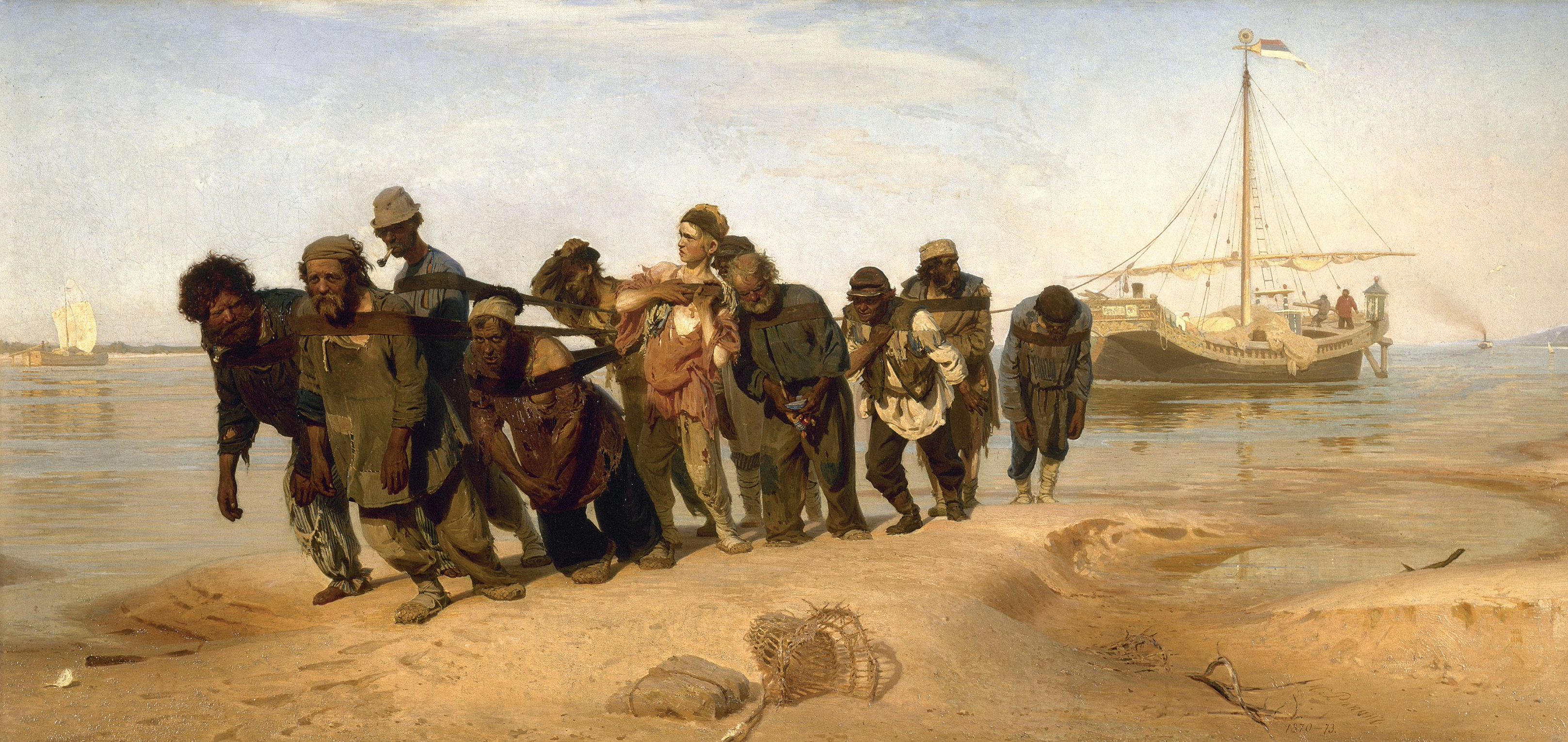
Barge Haulers on the Volga Painting by Ilja Repin
The State Russian Museum
Aknowledgement to Lars Linköldd

Slide 17
Tänan!

