Slide 1



DITS.UC
If you love something too much give it away
Jorge Figueira

Slide 2
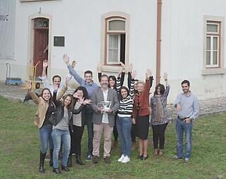

2003-2019
Tech Transfer Office Coordinator
Regional Innovation Ecosystem Executive Coordinator
UC R&D Int. Networks Coordin
UC Pedagogical Innovation Unit Coordin.
2010-2019
2020- …

Slide 3
Tech Transfer @UC
Some Indicators
200 + active patents
50% patents outlicensed
200+ spin-offs
60+ anual entrepreneurship awareness events
Several international and national awards

Slide 4
Create Awareness towards Entrepreneurship and Innovation Spirit
Key aspects:
Short trial & error cicles
Majority based on mentorship

Slide 5
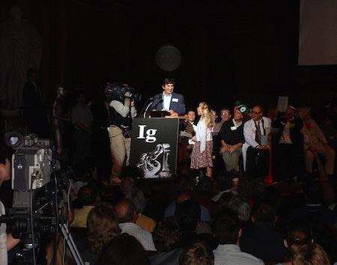
Trial & Error
Ig Nobel Prize 2004: Andre Geim

Slide 6
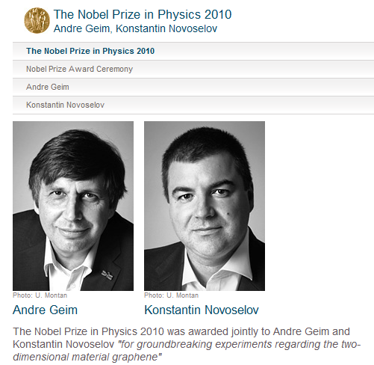

Slide 7
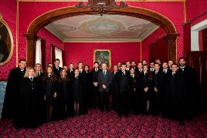




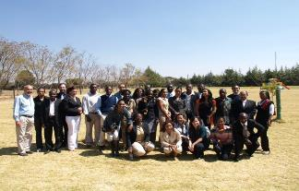


Slide 8
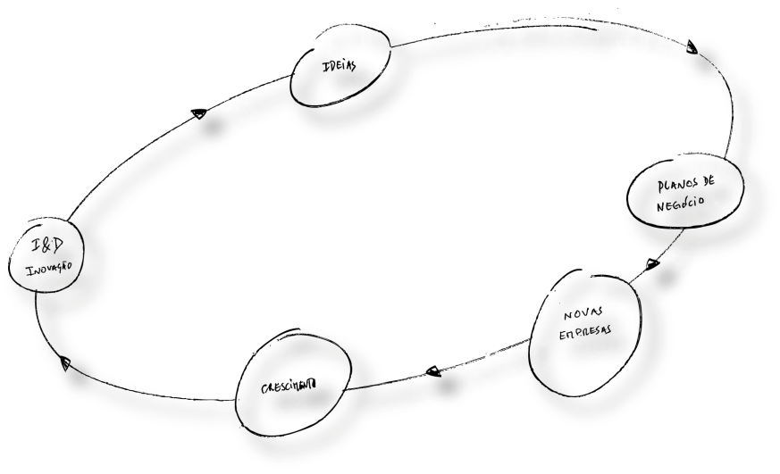

Innovation Ecosystem

Slide 9
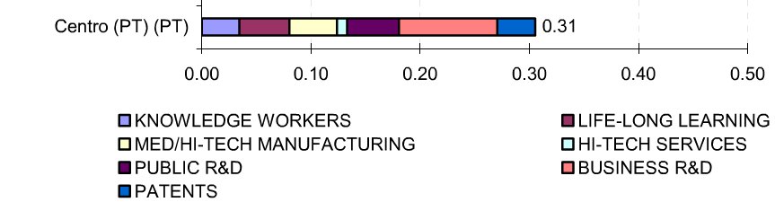
Regional Innovation Scoreboard 2006
Portuguese Center Region
2nd most innovative of the country
153th out of EU 208 Regions
Notes:
Numero de pessoas que finalizou o ensino superior
Número de pessoas entre os 25 e os 64 anos que ao longo da vida vai tirando formações
Número de trabalhadores na industria de média/alta intensidade tecnológica
Número de trabalhadores na industria de alta intensidade tecnológica
Investimento público em investigação e desenvolvimento
Investimento privado em investigação e desenvolvimento
Patentes submetidas por milhão de habitantes

Slide 10
Innovation Ecosystem
10 Nuclear Partners
Executivo
Ignition
Verification
Validation
Creation
(1st phase Incubation)
Acceleration
(2nd phase Incub.)
Consolidation
(3rd phase Incub.)
Development
Desenvolvimento
Empresa
Ideia de
Value Proposition
Start-up company
Business Idea
Proposta
Plano de
Business Plan
Empresa
“Teenage” Company
“Full grown”
company
Empresa
Empresa
I&D
“Mature” company
R&D
Neg
ó
cio
de Valor
Neg
ó
cio
Rec
é
m
-
Nascida
Adolescente
Adulta
Amadurecida
Licenciamento
Licensing
>600 Complementary Partners
Notes:
24 techscouter identificados
89 invention disclosures
92 pedidos de patentes e patentes (pedidos nacionais em cada país contabilizados)
23 Bolsas de Ignição atribuídas
28 Concursos de ideias de negócio organizados
62 candidaturas a concursos de inovação apoiadas
16% de cursos com unidades curriculares de Empreendedorismo e Inovação

Slide 11
Vision
“To transform the region towards an international reference for the knowledge creation, innovation and entrepreneurship in the areas of Life Sciences, Energy, Information & Communication Technology and Electronics & Creative Industries in order to become one of the 100 most innovative regions in Europe by 2022”

Slide 12
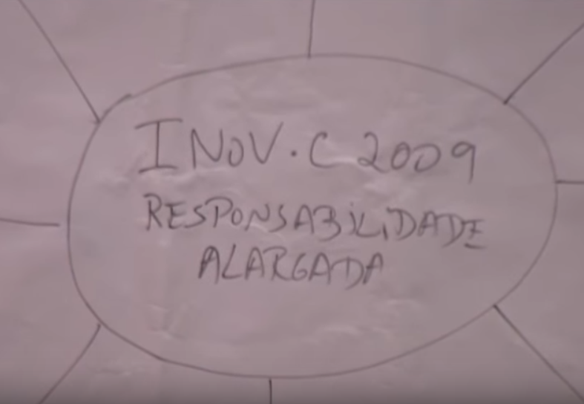
Should an University lead the regional Inovation Ecosystem? And How?

Slide 13
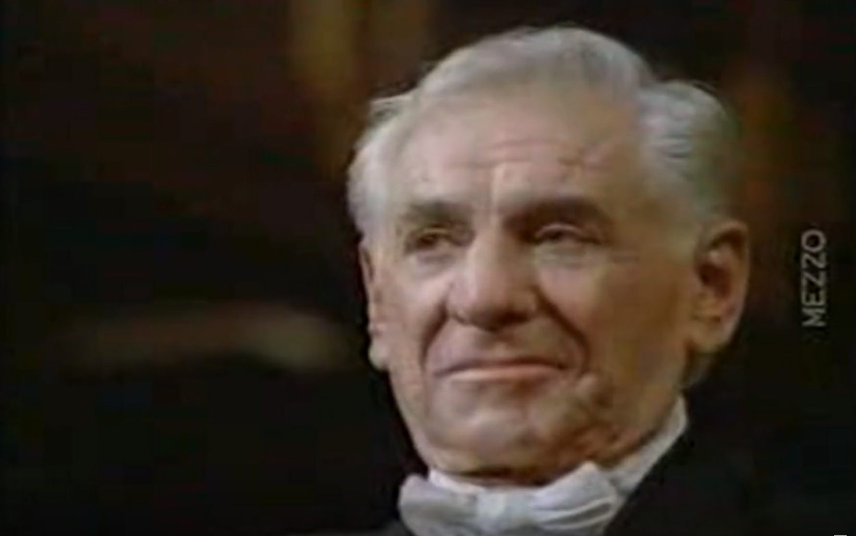
“If you love something too much give it away”

Slide 14
Immaterial Projects
I – Ecosystem Management, Promotion and Monitoring
EMPRESAS
COMPANIES
SISTEMA FINANCEIRO
FINANCIAL ENTITIES
INOV.C board
Conselho
“
INOV
Ÿ
C
”
Executive board
Conselho
Executivo
Strategic Programm Management
Communication and disclosure of the Programm
Managing stakeholders relationships
P
ÃO
Ú
ADMINISTRA
Ç
INNOVATION AGENTS
PUBLIC AUTHORITIES
AGENTES DA
BLICA
INOVA
Ç
ÃO
Sensibiliza
ç
ão e Forma
ç
ão em Inova
ç
ão e
Empreendedorismo
Gestão de Projectos
Gestão Integrada do Ecossistema e do Pipeline de Inova
ç
ão
Monitoriza
ç
ão e Controlo de Objectivos, Metas e Indicadores
Participa
ç
ão em Projectos e Parcerias Internacionais
Capta
ç
ão de IDI de Natureza Internacional e IDE
Gestão de Plano de Comunica
ç
ão e Imagem
SOCIEDADE
SOCIETY

Slide 15
Immaterial Projects
I – Ecosystem Management, Promotion and Monitoring
KPI reached

Slide 16
Immaterial Projects
II – Entrepreneurship and Innovation Promotion
Executivo
Ignition
Verification
Validation
Creation
(1st phase Incubation)
Acceleration
(2nd phase Incub.)
Consolidation
(3rd phase Incub.)
Development
Desenvolvimento
Empresa
Ideia de
Value Proposition
Start-up company
Business Idea
Proposta
Plano de
Business Plan
Empresa
“Teenage” Company
“Full grown”
company
Empresa
Empresa
I&D
“Mature” company
R&D
Neg
ó
cio
de Valor
Neg
ó
cio
Rec
é
m
-
Nascida
Adolescente
Adulta
Amadurecida
Licenciamento
Licensing
Notes:
24 techscouter identificados
89 invention disclosures
92 pedidos de patentes e patentes (pedidos nacionais em cada país contabilizados)
23 Bolsas de Ignição atribuídas
28 Concursos de ideias de negócio organizados
62 candidaturas a concursos de inovação apoiadas
16% de cursos com unidades curriculares de Empreendedorismo e Inovação

Slide 17
Immaterial Projects
II – Entrepreneurship and Innovation Promotion
Executivo
Ignition
Verification
Validation
Creation
(1st phase Incubation)
Acceleration
(2nd phase Incub.)
Consolidation
(3rd phase Incub.)
Development
Desenvolvimento
Empresa
Ideia de
Value Proposition
Start-up company
Business Idea
Proposta
Plano de
Business Plan
Empresa
“Teenage” Company
“Full grown”
company
Empresa
Empresa
I&D
“Mature” company
R&D
Neg
ó
cio
de Valor
Neg
ó
cio
Rec
é
m
-
Nascida
Adolescente
Adulta
Amadurecida
Licenciamento
Licensing
Technology Scouting Network
Identification of the R&D and innovation potential
Management of Intellectual Property
Ignition Grants System
Supporting and encouraging participation in national innovation contests
Introduction courses: Entrepreneurship and Innovation
Notes:
24 techscouter identificados
89 invention disclosures
92 pedidos de patentes e patentes (pedidos nacionais em cada país contabilizados)
23 Bolsas de Ignição atribuídas
28 Concursos de ideias de negócio organizados
62 candidaturas a concursos de inovação apoiadas
16% de cursos com unidades curriculares de Empreendedorismo e Inovação

Slide 18
Immaterial Projects
II – Entrepreneurship and Innovation Promotion
Executivo
Ignition
Verification
Validation
Creation
(1st phase Incubation)
Acceleration
(2nd phase Incub.)
Consolidation
(3rd phase Incub.)
Development
Desenvolvimento
Empresa
Ideia de
Value Proposition
Start-up company
Business Idea
Proposta
Plano de
Business Plan
Empresa
“Teenage” Company
“Full grown”
company
Empresa
Empresa
I&D
“Mature” company
R&D
Neg
ó
cio
de Valor
Neg
ó
cio
Rec
é
m
-
Nascida
Adolescente
Adulta
Amadurecida
Licenciamento
Licensing
Business Ideas Contests (Arrisca C)
Acceleration programs (Start-up weekend, iDay, Ineo Weekend, 3DS…)
Proof of concept system
Looking for private partners for licensing of IP
Notes:
24 techscouter identificados
89 invention disclosures
92 pedidos de patentes e patentes (pedidos nacionais em cada país contabilizados)
23 Bolsas de Ignição atribuídas
28 Concursos de ideias de negócio organizados
62 candidaturas a concursos de inovação apoiadas
16% de cursos com unidades curriculares de Empreendedorismo e Inovação

Slide 19
Immaterial Projects
II – Entrepreneurship and Innovation Promotion
Executivo
Ignition
Verification
Validation
Creation
(1st phase Incubation)
Acceleration
(2nd phase Incub.)
Consolidation
(3rd phase Incub.)
Development
Desenvolvimento
Empresa
Ideia de
Value Proposition
Start-up company
Business Idea
Proposta
Plano de
Business Plan
Empresa
“Teenage” Company
“Full grown”
company
Empresa
Empresa
I&D
“Mature” company
R&D
Neg
ó
cio
de Valor
Neg
ó
cio
Rec
é
m
-
Nascida
Adolescente
Adulta
Amadurecida
Licenciamento
Licensing
Courses in Entrepreneurship, Innovation, Intellectual Property and Technology Transfer
Participation in national and international Brokerage events
Support the development of business plans
Business plan competition
Support and encourage participation in national and international entrepreneurship contests: Lena Business, Start, Audax, I2P etc..
Notes:
24 techscouter identificados
89 invention disclosures
92 pedidos de patentes e patentes (pedidos nacionais em cada país contabilizados)
23 Bolsas de Ignição atribuídas
28 Concursos de ideias de negócio organizados
62 candidaturas a concursos de inovação apoiadas
16% de cursos com unidades curriculares de Empreendedorismo e Inovação

Slide 20
Immaterial Projects
II – Entrepreneurship and Innovation Promotion
Executivo
Ignition
Verification
Validation
Creation
(1st phase Incubation)
Acceleration
(2nd phase Incub.)
Consolidation
(3rd phase Incub.)
Development
Desenvolvimento
Empresa
Ideia de
Value Proposition
Start-up company
Business Idea
Proposta
Plano de
Business Plan
Empresa
“Teenage” Company
“Full grown”
company
Empresa
Empresa
I&D
“Mature” company
R&D
Neg
ó
cio
de Valor
Neg
ó
cio
Rec
é
m
-
Nascida
Adolescente
Adulta
Amadurecida
Licenciamento
Licensing
Support the creation of companies,
Incubation facilities management
Fund raising support
Tax and Intellectual property guidance
Training programs
IP Negotiation
Notes:
24 techscouter identificados
89 invention disclosures
92 pedidos de patentes e patentes (pedidos nacionais em cada país contabilizados)
23 Bolsas de Ignição atribuídas
28 Concursos de ideias de negócio organizados
62 candidaturas a concursos de inovação apoiadas
16% de cursos com unidades curriculares de Empreendedorismo e Inovação

Slide 21
Immaterial Projects
II – Entrepreneurship and Innovation Promotion
Executivo
Ignition
Verification
Validation
Creation
(1st phase Incubation)
Acceleration
(2nd phase Incub.)
Consolidation
(3rd phase Incub.)
Development
Desenvolvimento
Empresa
Ideia de
Value Proposition
Start-up company
Business Idea
Proposta
Plano de
Business Plan
Empresa
“Teenage” Company
“Full grown”
company
Empresa
Empresa
I&D
“Mature” company
R&D
Neg
ó
cio
de Valor
Neg
ó
cio
Rec
é
m
-
Nascida
Adolescente
Adulta
Amadurecida
Licenciamento
Licensing
Support business development and internationalization
Business development (Business intelligence, prospect for new opportunities, support the trade policies and training of teams)
Support the increase in technology-intensive enterprises by facilitating the transfer and commercialization of technologies and contacts with entities of the NSTS
Missions abroad to expand and capture new markets
Notes:
24 techscouter identificados
89 invention disclosures
92 pedidos de patentes e patentes (pedidos nacionais em cada país contabilizados)
23 Bolsas de Ignição atribuídas
28 Concursos de ideias de negócio organizados
62 candidaturas a concursos de inovação apoiadas
16% de cursos com unidades curriculares de Empreendedorismo e Inovação

Slide 22
Immaterial Projects
II – Entrepreneurship and Innovation Promotion
Executivo
Ignition
Verification
Validation
Creation
(1st phase Incubation)
Acceleration
(2nd phase Incub.)
Consolidation
(3rd phase Incub.)
Development
Desenvolvimento
Empresa
Ideia de
Value Proposition
Start-up company
Business Idea
Proposta
Plano de
Business Plan
Empresa
“Teenage” Company
“Full grown”
company
Empresa
Empresa
I&D
“Mature” company
R&D
Neg
ó
cio
de Valor
Neg
ó
cio
Rec
é
m
-
Nascida
Adolescente
Adulta
Amadurecida
Licenciamento
Licensing
Conferences and seminars to raise awareness of Entrepreneurship, Innovation, Intellectual Property
Entrepreneurship Web 2.0 dedicated to entrepreneurship and innovation - including a forum for answering questions
Interactive Events on Entrepreneurship
Creation of network of student volunteers in the various IES
Management of relationship with Junior Enterprises, Associations of students and others.
International promotion of entrepreneurship courses, innovation, knowledge transfer and e-learning.
Survey of current and former students opinion of the Universities/Colleges - Inventory of entrepreneurship
Notes:
24 techscouter identificados
89 invention disclosures
92 pedidos de patentes e patentes (pedidos nacionais em cada país contabilizados)
23 Bolsas de Ignição atribuídas
28 Concursos de ideias de negócio organizados
62 candidaturas a concursos de inovação apoiadas
16% de cursos com unidades curriculares de Empreendedorismo e Inovação

Slide 23
Ignition grants
N proposals received | 110
Nº approved proposals | 37
 | Ignition Grants Impact (2010-2011)
Start-up created | 4
Investment raised after | 1,3M€ (x6 of the total value invested in Ignition Grants)
Provisional patents | 5
International patents (PCT) | 2
European patents | 1
Awards on business idea contests | 2
Licensing process | 4

Slide 24
Immaterial Projects
III – Innovation contribution for local and regional development
EMPRESAS
COMPANIES
SISTEMA FINANCEIRO
FINANCIAL ENTITIES
Conselho
“
INOV
Ÿ
C
”
Conselho
Executivo
Support for initiatives to stimulate entrepreneurship and innovation locally and regionally
Support the development of local and regional projects to stimulate innovation
Support and liaison with the network habitat and incubators in the region
P
ÃO
Ú
ADMINISTRA
Ç
INNOVATION AGENTS
PUBLIC AUTHORITIES
AGENTES DA
BLICA
INOVA
Ç
ÃO
Sensibiliza
ç
ão e Forma
ç
ão em Inova
ç
ão e
Empreendedorismo
Gestão de Projectos
Gestão Integrada do Ecossistema e do Pipeline de Inova
ç
ão
Monitoriza
ç
ão e Controlo de Objectivos, Metas e Indicadores
Participa
ç
ão em Projectos e Parcerias Internacionais
Capta
ç
ão de IDI de Natureza Internacional e IDE
Gestão de Plano de Comunica
ç
ão e Imagem
SOCIEDADE
SOCIETY

Slide 25


Contributos da Inovação para o Desenvolvimento Local e Regional
Immaterial Projects
III – Innovation contribution for local and regional development
Evaluation criteria
Potential to create entrepreneurial projects within 2 years
Innovative approach
Replicability in the region
Establishing lasting relationships and consolidation of the contact network
Appropriate requested budget for the project
Resources and expertise of nuclear partner critical to success of the project
Example of success / good practices in the region and the country

Slide 26
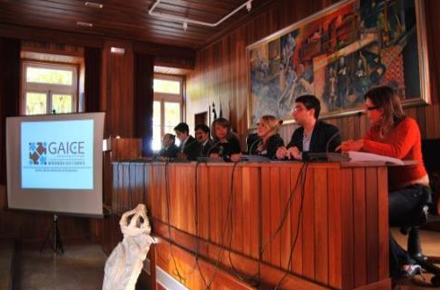
Contributos da Inovação para o Desenvolvimento Local e Regional
Immaterial Projects
III – Innovation contribution for local and regional development
Nuclear partner: IPN
Supporting partner: Miranda-do-Corvo Municipality
Project: GAICE
Missão:
Creation of a local office in Miranda-do-Corvo municipality to foster local entrepreneurship with strong link to IPN.
Specialized training at IPN
Notes:
O apoio do parceiro nuclear IPN veio colmatar a falta de know-how especializado na área da criação de empresas, e no apoio a empreendedores que queiram desenvolver os seus projetos no município de Miranda do Corvo. Dois técnicos da CM de Miranda do Corvo realizaram um período inicial de estágio na IPN-Incubadora por forma a adquirirem metodologias e ferramentas de trabalho para dar posteriormente dar apoio aos empreendedores do município.

Slide 27








Shared Experience

Slide 28
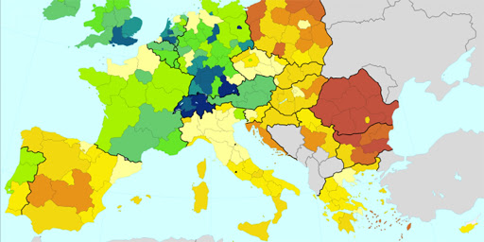
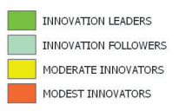
Regional Innovation Scoreboard
2006 - 153 - Moderate Low
2009 - Top 121 - Moderate Medium
2012 - Top 100 - Follower Low
2014 – Moderate Innovator
2020 – Innovation Leader
Notes:
RIS 2012
Innovation Leader
Dentro das 100 regiões mais inovadoras da Europa.

Slide 29


If you love something too much give it away
Itay Tagram
Thank you
Jorge Figueira
jfigueira@uc.pt

