Slide 1
Tools for Biomarker Commercialization
The BiC Project
Valerie Daussin Laurent
Team Leader Business Development, Project Leader BIC
Aalborg University Hospital

Slide 2
BIC Project partners and Funding
A transnational cooperation of 3 research and 5 cluster organizations in the Baltic Sea Region:
Denmark (Coordination: Aalborg University Hospital)
Germany
Poland
Finland
Estonia
Lithuania
Project budget is EUR 2,55 million and it is co-financed by the European Regional Development Fund through the Interreg Baltic Sea Region Programme with EUR 1,96 million.

Slide 3
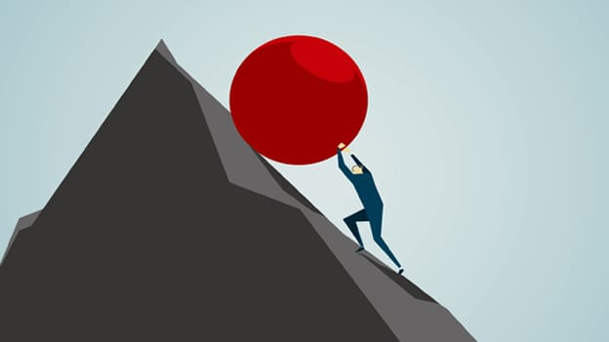
BIC – the goal of the project
Challenges identified
How do you translate a biomarker discovery from lab to clinical setting?
How to ensure efficient validation phase and generation of valid data?
How to ensure that the researchers have adequate knowledge about the commercialization of biomarkers?
How does a TTO select the best biomarkers projects for commecialization?
How to provide industry or investors relevant documentation

Slide 4
Interview conclusions, Researchers
Researchers generally had limited experience with commercialization
Researchers are well aware of the technical requirements for a biomarker
Regulatory aspects are not generally occupying the researchers
Researchers would benefit of guidance and training in e.g. IPR and regulatory issues, systematic product development and making market and competition analyses
Suggestions for TTOs from researchers:
Organizing mentoring, training, expert services (validation process, regulatory aspects)
Organizing networking with companies and end-users
A clear roadmap on biomarker development with relevant guidelines

Slide 5
Interview Conclusions – Large Companies
Development of biomarkers is exclusively based on market and clinical needs and cost benefit analyses
Only biomarkers that are patented with a demonstrated proof of concept fulfill the criteria for entering into a collaboration
The large drug development companies are continuously scouting to find interesting biomarker projects
The drug development companies are willing to collaborate, at least after a patent has been granted, as well as validation and proof of concept.
Today there seem to be a development gap between the identification of a biomarker and the clinical validation.

Slide 6
Interview Conclusions - SMEs
The main steps for biomarker development should be – to pick the right methodology, find freedom-to-operate or protect the IP, develop the assay, then validate it and develop a sustainable business model.
Keep reimbursement in mind, to get back the money invested
Difficult to get into clinics since doctors are busy and no clear path exists
Difficult to access clinical samples
A marker should fit to already existing workflows on the technological and clinical level.
IP is important, either one’s own or via access through licensing.
A matchmaking tool would be good

Slide 7
Interview Conclusions – End Users
Challenges in taking a new biomarker into use in clinical practice include: Price, Availibility, Lack of competencies + time to convince clinicians and other key stakeholders of the biomarker´s usefulness
Biomarker assays must include a clear medical need and demonstrated usefulness (health benefits, proven added value) – as well as good and sufficient clinical validation
Common economic aspects include: high unmet medical need, benefit of new biomarker test, average price of the most common tests is under ten euros, Health Insurance Companies often pay for diagnostics –reimbursement is crucial
To get the CE mark takes much time (years); in-house test´s validation takes less time (months)

Slide 8
Interview Conclusions – TTO’s
The TTOs have different experience in commercializing biomarkers and all agree that currently there is no proven successful pathway for this.
Guidelines ensuring that researchers become aware of the basic demands for commercialization in the early phases of their research are needed
The key issue include the timing related to patent application (national phases) and validation requirements. But to commercialize a biomarker, you need to have a patent
Often it would be better to wait with the patent application to get sufficient validation, but this often conflicts with the researchers’ wishes to publish

Slide 9
Interview Conclusions - Investors
Biomarker area is developing fast, but it is difficult because of lacking information and thus it being hard to convince the industry
ROI is very important to address – the patenting process is very costly
Main patent areas: UK, Germany, France, Japan, USA. Investors nowadays consider also China and India
Big companies are not interested in the early stage of development, so potential investor should be prepared to address the regulatory challenges

Slide 10
Interview Conclusions – Cluster Organisations
Biomarkers rarely a specific focus area. Clusters may play a role in national/regional agenda setting promoting biomarkers potential
Reimbursement - Despite CE regulation, each country has own additional rules
High cost of biomarkers not a hinder if benefits are even larger
Marketing and QA underestimated. Cultural barriers between research and industry and between research and hospitals significant. Only very few good cases on biomarker development reaching the market.

Slide 11
BiC - Achievements
BIC Guide Tool incl. Self evaluation tool
A Best Practice Handbook
Screening and Selection guide for TTO’s
Guidelines for Regulatory Requirements

Slide 12
The BIC Guide

Slide 13
BIC Guide: main features
Creates overview of the process
7 phases (TRL based) 3 tracks. A list of tasks
Support documents for specific tasks
Check list and self evaluation tool at the end of each phase
Link to useful material
However: Only the 5 first phases covered at this stage (research phases)

Slide 14
The BIC Guide ( BIC Master Tool) Test version
https://bicmastertool.nu/flow/bic-master-tool/

Slide 15
The BIC Guide (MasterTool) - Overview
Research phase
Technology transfer
Industrial and market phase

Slide 16
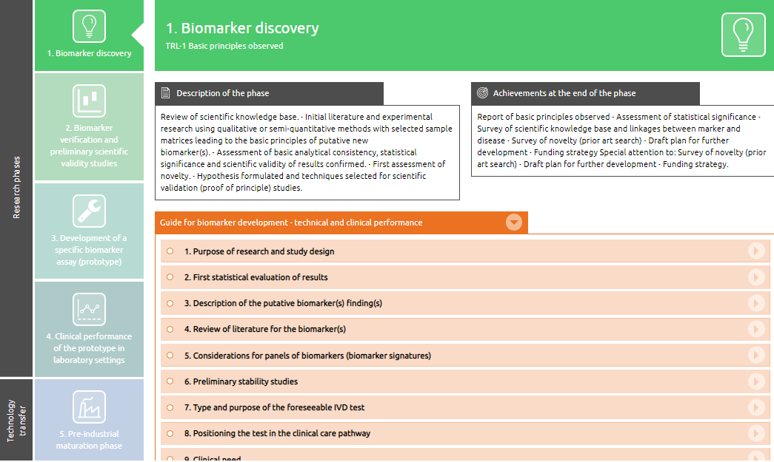
The BIC Guide (MasterTool) - Overview

Slide 17
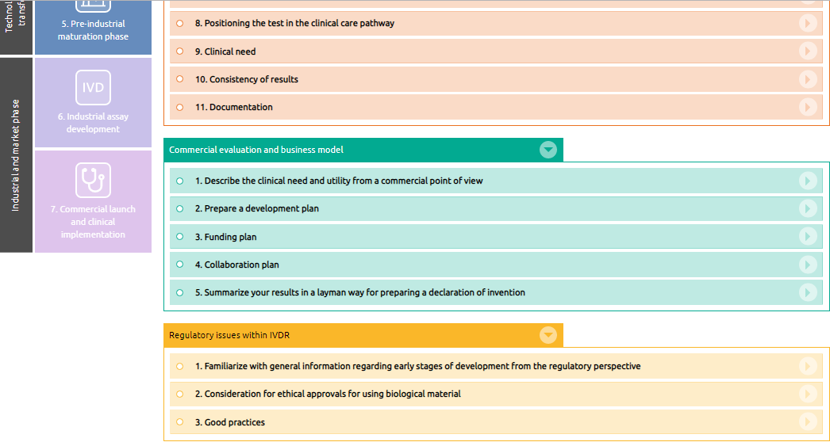
The BIC Guide (MasterTool) - Extractions

Slide 18
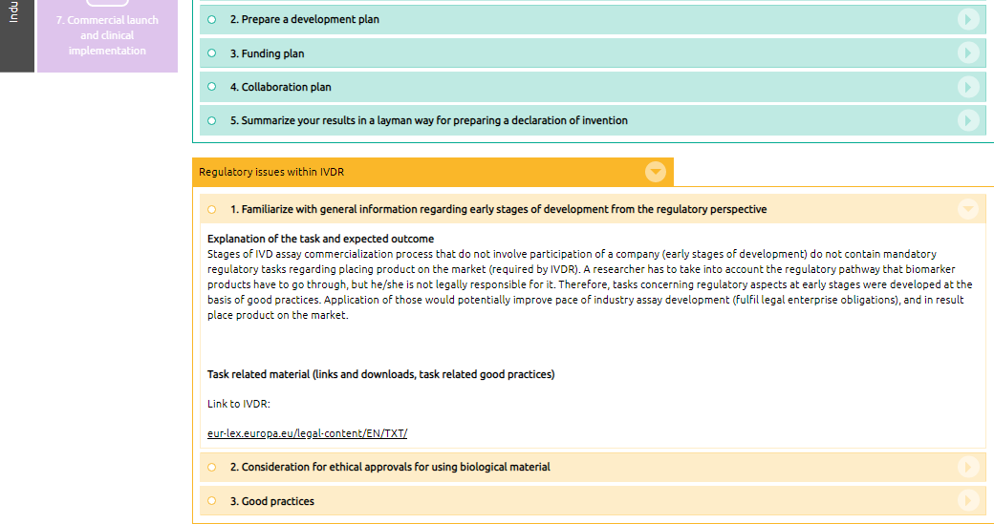
The BIC Guide (MasterTool) - Extractions

Slide 19
The BIC Guide testing phase
In the periode from 1 October 2019 to the end of march 2020, a selected group of researchers, SMEs and TTOs in the Baltic Sea Region (BSR) have tested the BIC Guide developed by the BIC Consortium. This tool provides guidance through technical, clinical, commercial and regulatory aspects of biomarker commercialization process.
Based on the results collected from the test phase, the BIC Guide is currently revised and a final version will be available to the public free of charge in summer 2020.
By enabling better and more efficient commercialization of biomarkers, the overall output of the BIC project will contribute in improving realization and competitiveness of biomarkers discoveries primarily within BSR.

Slide 20
BIC Guide: main feedback
- to be integrated in the final version
„ The items are great! They serve as good reminders for any scientists in the field.“ (Finnish researcher)
„Very, very useful for any scientist. There are lots of things we are going to include in our future processes and projects.“ (Finnish researcher)
„The online tool is very intuitive and easy to use. The content is very fine, meaningful and helpful.” (Danish researcher)
„The regulatory track is not very close to scientists.” (Finnish researcher)
„However the commercialization and regulatory tracks may overload the researchers. We probably would not look at those very much.“ (Finnish researcher)
“We are not familiar with regulatory tasks, and there is very little interest to getting closer to them, as long as the necessity to apply them belongs to another group.” (Danish researcher)
“There has to be a perfect conformity between regulations and regulatory descriptions in MT in order to really make the tool usable.”

Slide 21
The BIC Guide (MasterTool) – Expectation and first impressions
Main Expectations / expected benefit
Structured overview of the BIC process
A good list of activities which needs to be done in the commercialization of new biomarkers.
Comprehensive informational material regarding the BIC process
Time savings for searching for information on different aspects of biomarker development
First impressions on the BIC MasterTool
First tool to support the commercialization pathway in such comprehensive way
Well structured, designed and self-explanatory

Slide 22
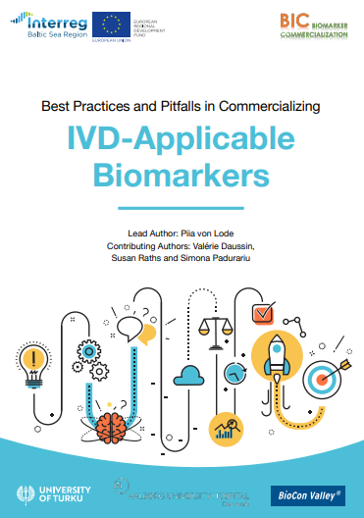
BIC Best Practices Handbook

Slide 23
BIC Best Practices Handbook: main chapters
CLINICAL IMPACTS OF IVD-APPLICABLE BIOMARKERS
THE IVD-APPLICABLE BIOMARKER PIPELINE
COMMERCIALIZATION ASPECTS
INTELLECTUAL PROPERTY RIGHTS (IPR)
BUSINESS MODELS, AGREEMENTS AND OTHER LEGAL VIEWPOINTS

Slide 24
BIC Best Practices Handbook: extractions
SCOPE OF PATENT PROTECTION
The most important characteristic of a patent is its scope of protection, which defines whether potential utilizers need a license for it or not.
Broad patent claims are especially important in the case of selling or licensing the IPR for companies for a fee. In the industry the primary aim of patenting is typically not out-licensing but protecting the existing or upcoming products and/or increasing the value of the enterprise.
Best practices:
To ensure that the university-owned IPR becomes interesting to companies: it needs to be patented well and with broad enough patent claims
If the intention is to form a start-up, the viewpoint of protecting the planned products can be emphasized somewhat more.
Also make a plan for the territorial coverage of the patent family.
Things that are difficult to patent well: etc…

Slide 25
BIC Best Practices Handbook: extractions
FREEDOM TO OPERATE (FTO)
Freedom-to-operate means not infringing the IPR rights (almost always patents) of others and not needing licenses -- that may be costly or unavailable -- for IP owned by third parties when commercializing the invention.
For example, to use reagents (such as antibodies) in a commercial kit, one needs to agree with the provider that the use of the component in a commercial product is allowed.
Furthermore, one needs to make a survey that there are no existing method patents that would cover the use of the reagent in the same indication.
Best practices: ……

Slide 26
BIC Best Practices Handbook: extractions
TIPS ON CONDUCTING A COMPETITION ANALYSIS
To have commercial use, a novel IVD test needs to solve a true clinical problem and be backed-up by convincing evidence. It also needs somehow to be better than competing approaches or add value to the existing testing sequence.
Best practices to conduct your own competition analysis:
Describe the current practices (especially the golden standard) used as a routine in the clinic and their limitations.
Conduct a literature search (both in scientific and patent databases) for alternative (competing) approaches to solve the above shortcomings.
It is important to recognize and describe the significant benefits of the new invention over the competing approaches. Acceptable advantages include, e.g.
Increased diagnostic sensitivity and specificity
Earlier diagnoses (less advanced diseases with less complications)
Improved convenience and patient compliance
Expected reduced number hospital admissions or length-of-stay

Slide 27
BIC Best Practices Handbook: extractions
INTELLECTUAL PROPERTY RIGHTS (IPR) in early stage projects
Most commercial partners will not consider licensing without respective intellectual property (IP) protection due to the competitive edge it provides. The existence of IP rights (IPR) is paramount also in the eyes of investors.
Furthermore, concrete IPR allows ensuring a share of profits to both the inventors and the research organization after the launch of the product.
Using patents as a source of information
Approximately 70-85 % of information found in patent databases cannot be found elsewhere. Researchers that follow the patenting field will have a significant advantage compared to those who are not up-to-date on the newest directions of commercial development.
Patenting versus publishing: alternative protection strategies for early phase inventions

Slide 28
Screening and Selection Guide for TTO’s

Slide 29
BIC Screening and Selection Guide for TTO’s
Characteristics of the biomarker(s)
Name(s), synonym(s), acronyms and all different codes of the biomarker(s): ___________________________________________________________
Disease/condition under investigation: __________________________________
Applicable molecular forms:
DNA
mRNA
other, e.g. modification of polynucleotide: ________________________
protein
modification of a protein (e.g. glycovariant): ______________________
metabolite
other, which:________________________________________________
Sample matrixes accepted: ____________________________________________
Stability of the biomarker in above matrixes (RT, -20 °C, freeze-thaw cycles, recovery-% etc.):

Slide 30
BIC Screening and Selection Guide for TTO’s
Description of the IVD test planned
Test type
Diagnostic
Prognostic
Predictive, for which therapy:
Screening
Risk/susceptibility
Companion diagnostics, for which drug:
Non-IVD applicable marker, specify type of use:
Other:__________________________________________________
Intended purpose of the test: ___________________________________________
Is the test able to detect the disease at an early stage?
Yes, before clinical symptoms
Yes, directly after onset of the acute disease
No
If no, can the disease yet be successfully treated at the time of positive test result?

Slide 31
BIC Screening and Selection Guide for TTO’s
Target population
Prevalence of the disease/condition in (different) population(s): __________________________________________________________
Who would be tested:
Entire population
Specific subgroup of the population, which:___________________
Entire population of the sick (with already established diagnosis)
Specific population of the sick, which:_________________________
Share amongst all sick: _______ %
Newborn
Adults with age range of: _________
Elderly
Female
Male
Specific ethnicities:_________________________________________
Specific timing or other trigger of testing, when:_________________
Contraindications for testing, which/when:

Slide 32
Guidelines for regulatory process

Slide 33
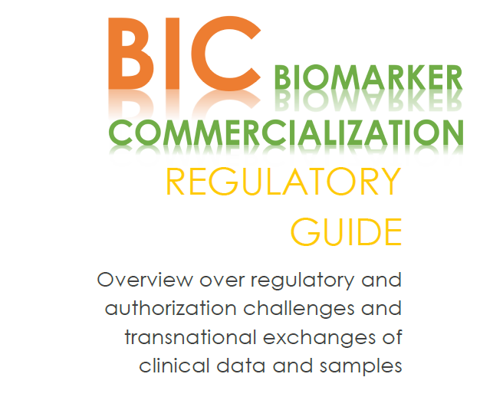
BIC Guidelines for regulatory process

Slide 34
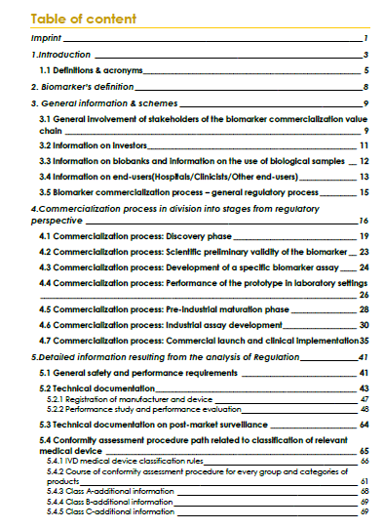
BIC Guidelines for regulatory process

Slide 35
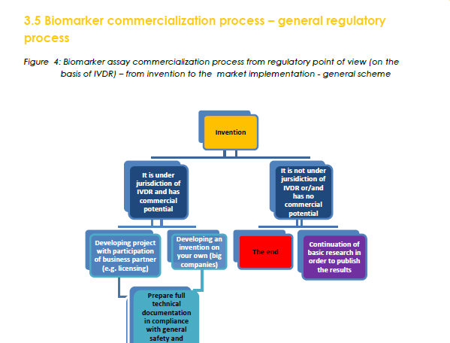
BIC Guidelines for regulatory process

Slide 36
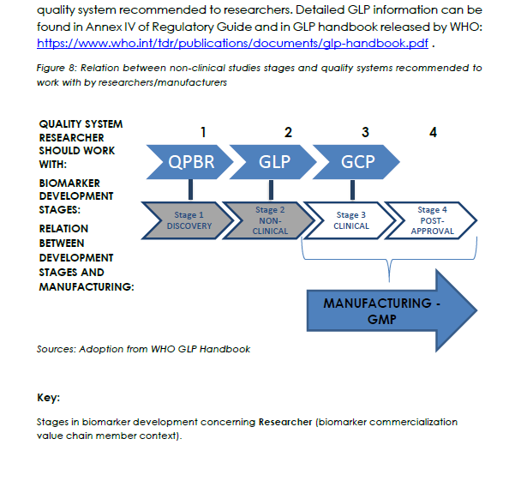
BIC Guidelines for regulatory process

Slide 37
Thank you for your attention !
More information: biomarker.nu
https://www.linkedin.com/company/bic-biomarker-commercialization
Valerie Daussin Laurent
Team Leader Business Development, Aalborg University Hospital
vkd@rn.dk

