Slide 1
European Commission support for early start-ups and innovators
Merike Leego, Merike.Leego@eithealth.eu, +46 731 553 023, +372 5281488
5th of November 2022, Estonia, Tartu

Slide 2
Innovation is priority for European Commission!
There are variety of support programs for implementation of new ideas into everyday practice.
The driving forces of innovation are start-ups and SMEs, who bring the smart products and services to the matrket.

Slide 3
What are the steps in order to go the market with new product or service?
1. Market analysis
Business model,
preliminary cost calculations
8. Validation by end-users
10. Sales and Marketing strategy, pricing
Idea Generation
Develop-ment
Regulation
Reimburse-ment
Adoption
Delivery
Scale
2. IP strategy
5. Clinical Trials
6. Cost-benefit analysis
9. Market analysis
4. CE-mark
7. Microscale production
There are different support programs for different innovation maturity levels (IML/TRL).

Slide 4
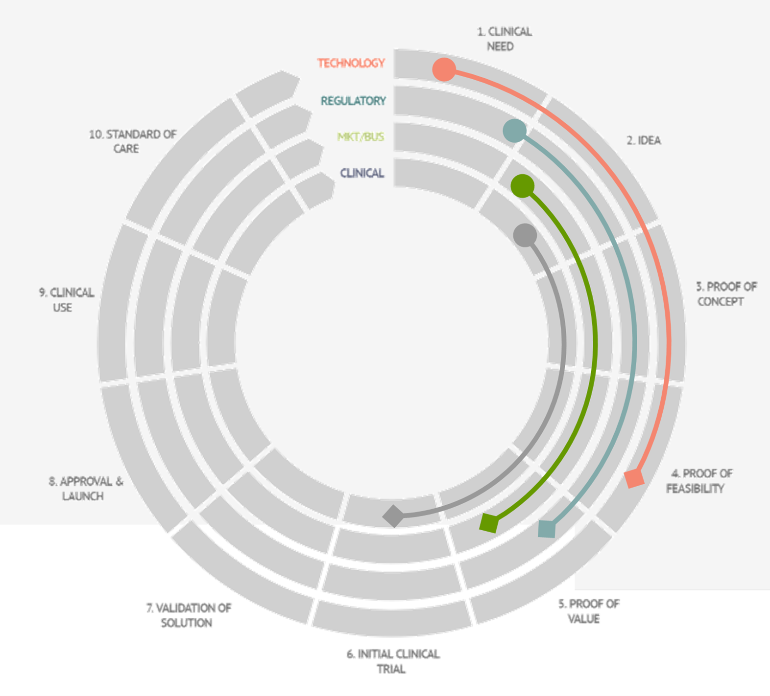
CIMIT – innovation rediness levels in healthcare
Read more: https://www.gaits.org/

Slide 6
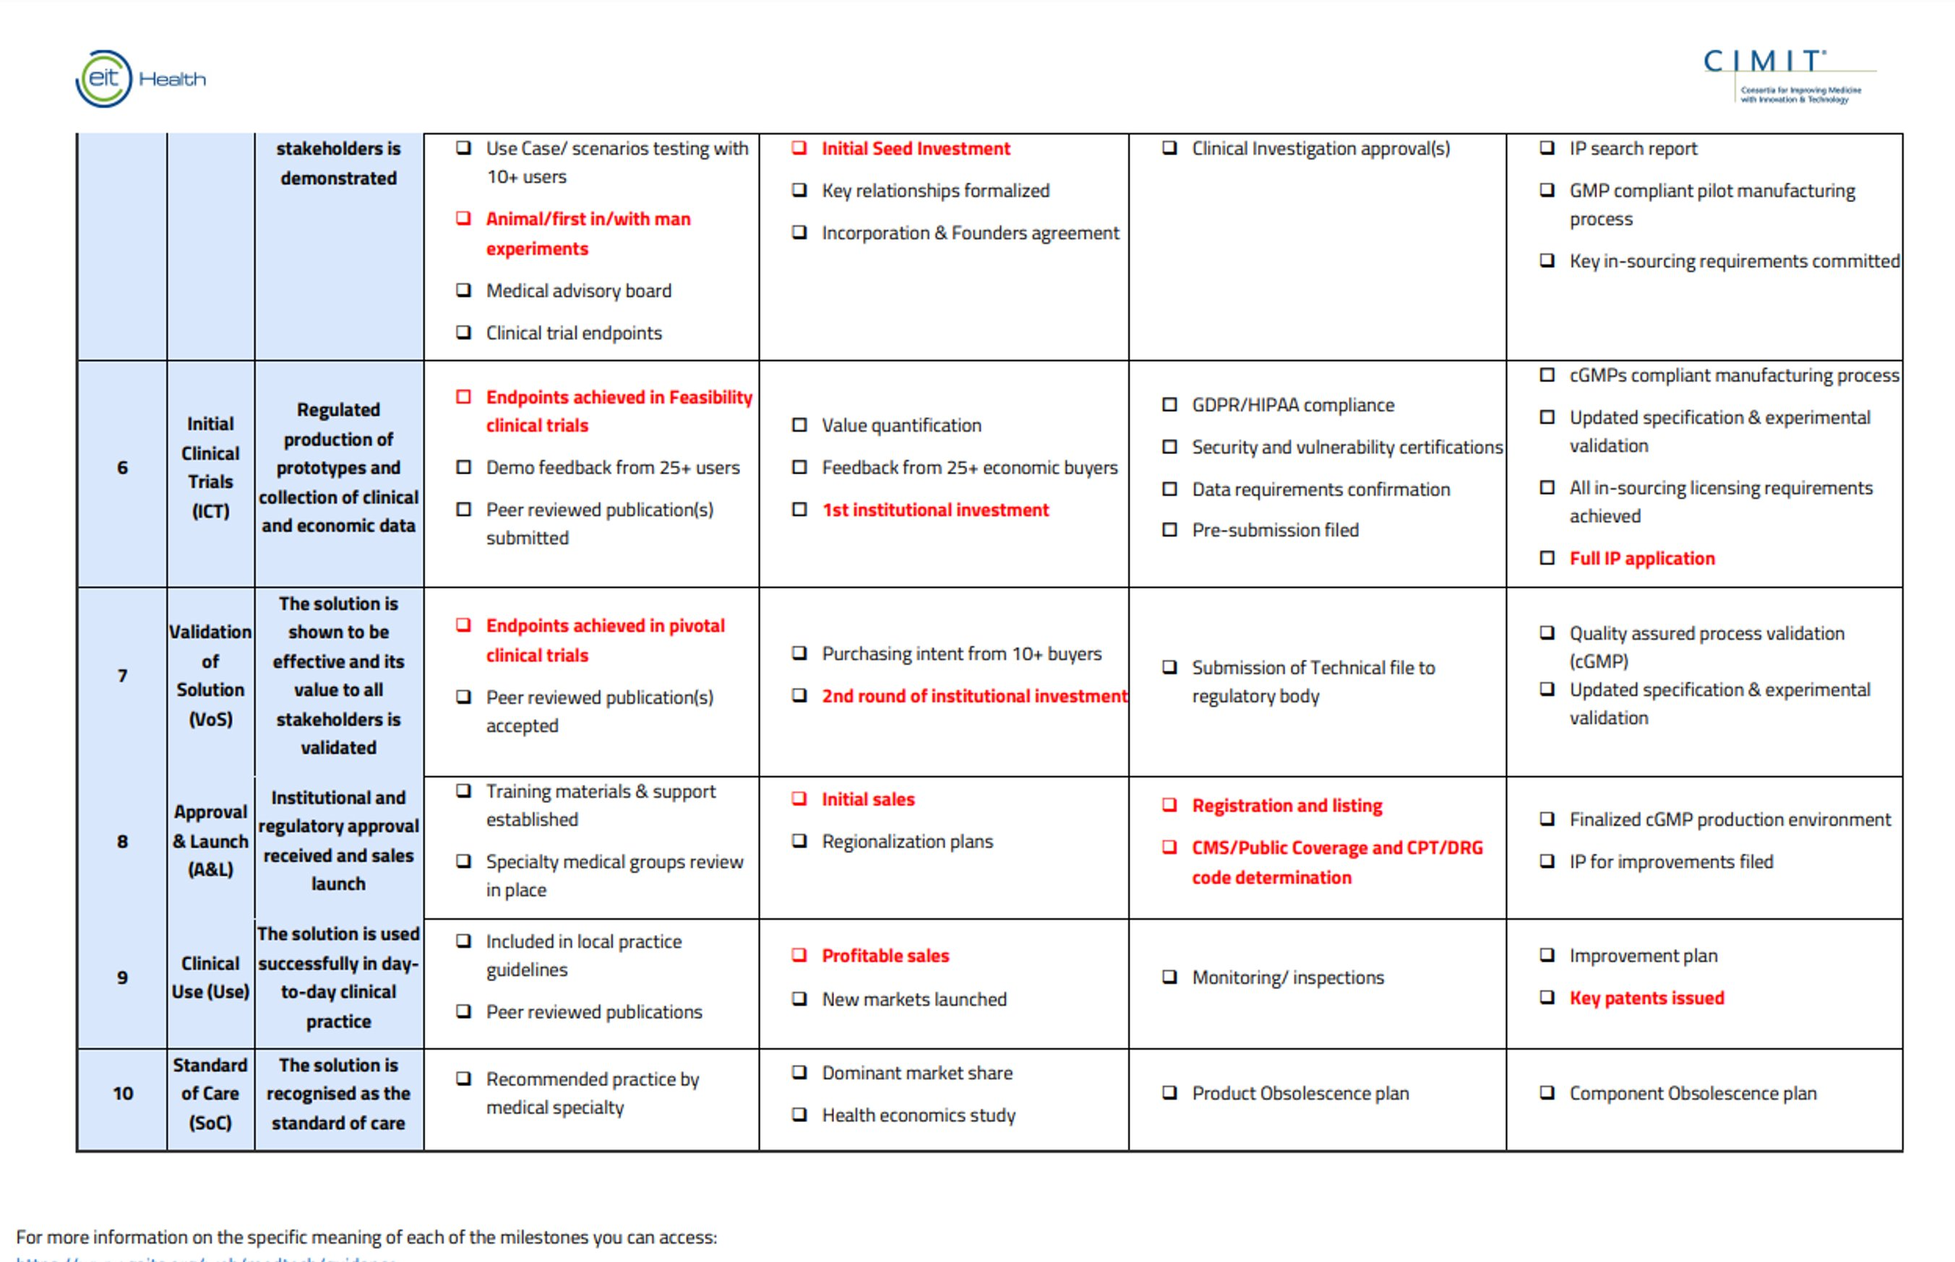

Slide 8
EU Support for start-ups and innovators
EIC: > €1.7 billion in 2022
https://eic.ec.europa.eu/index_en
EIT: >950 M EUR in 2022 https://eit.europa.eu/

Slide 9
EC different support schemas in health sector based on challenge, target group and maturity level

Slide 10
EC different support schemas in health sector based on challenge, target group and maturity level, incl. EIT Health support

Slide 11
More information about EC support programs for health start-ups:
Eureka Eurostars: https://www.eurekanetwork.org/countries/estonia/eurostars/
Coordinated by EC, co-funding and application/dissemination on national level
Options in Estonia via EAS: https://www.eurekanetwork.org/countries/estonia/eurostars/funding, max funding 300K EUR/project, EAS covers 60% of start-up costs and 50% of SME costs.
Vt. ka: https://eas.ee/grants/eurostars/
IHI (Innovative Health Initiative, previously IMI Innovative Medicine Initiative): https://www.ihi.europa.eu/apply-funding/future-opportunities
- Calls are closed now, but topics for next calls are opened, funding in millions, big consortiums needed.
Once a topic is published on the Funding and Tenders Portal as part of an IHI Call for proposals, organisations can publish their interest and expertise on the topic page. Partner search tool.
Call documents: https://www.ihi.europa.eu/apply-funding/call-documents

Slide 12
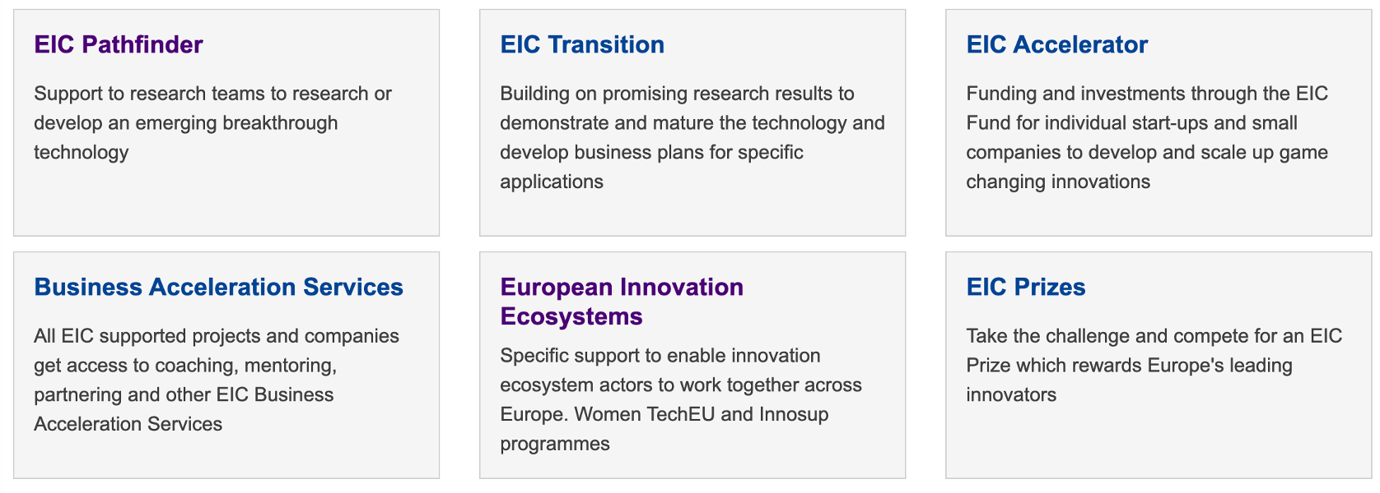
EIC calls
Currently closed, will be open again in 2023
EIC Community platform:
https://eic.eismea.eu/community/
Read more: https://eic.ec.europa.eu/eic-funding-opportunities_en

Slide 13
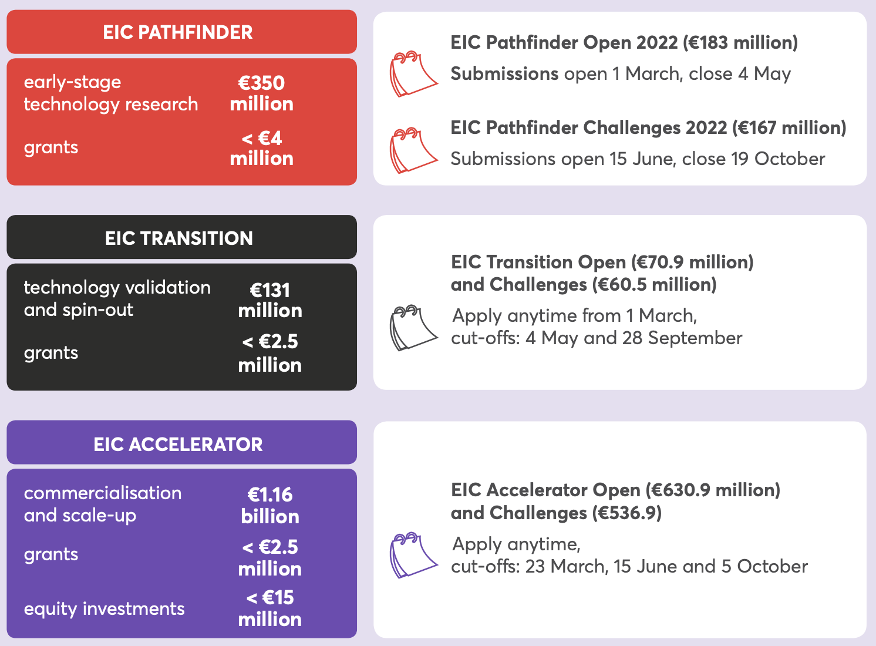
EIC calls in 2022
EIC Funding opportunities: https://eic.ec.europa.eu/eic-funding-opportunities_en
EIC infoday 22th of February, 2022 - recording: https://www.youtube.com/watch?v=8m7-N5AC5rw
TRL1>TRL3/4
*
*
*
TRL3/4>TRL5/6
*
*
Draft program with Challenges’ topics for 2023 is available:
https://sciencebusiness.net/sites/default/files/inline-files/EIC_WP_2023_second%20Draft.pdf
TRL5/6>TRL9

Slide 15
Database of funded projects: https://eic.easme-web.eu/

Slide 16
One of the European Commission’s ”KICs” (Knowledge and Innovation Communities).
https://eit.europa.eu/
All Communities provide:
- Funding
- Services
- Network
X-KIC activities/calls.

Slide 17
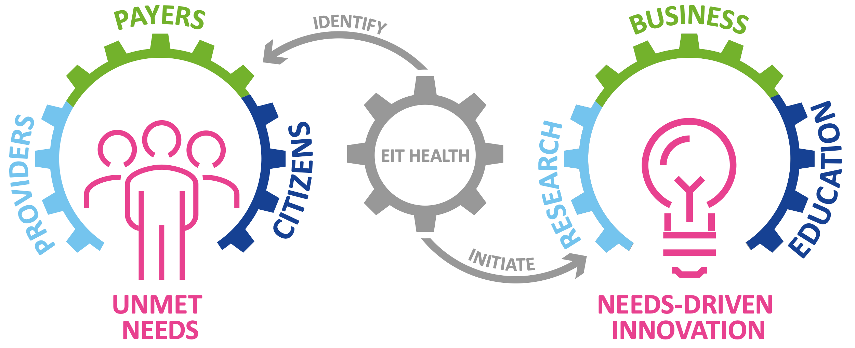
EIT as community
Based on identified needs, we initiate innovation by bringing together education, business, and research.

Slide 18
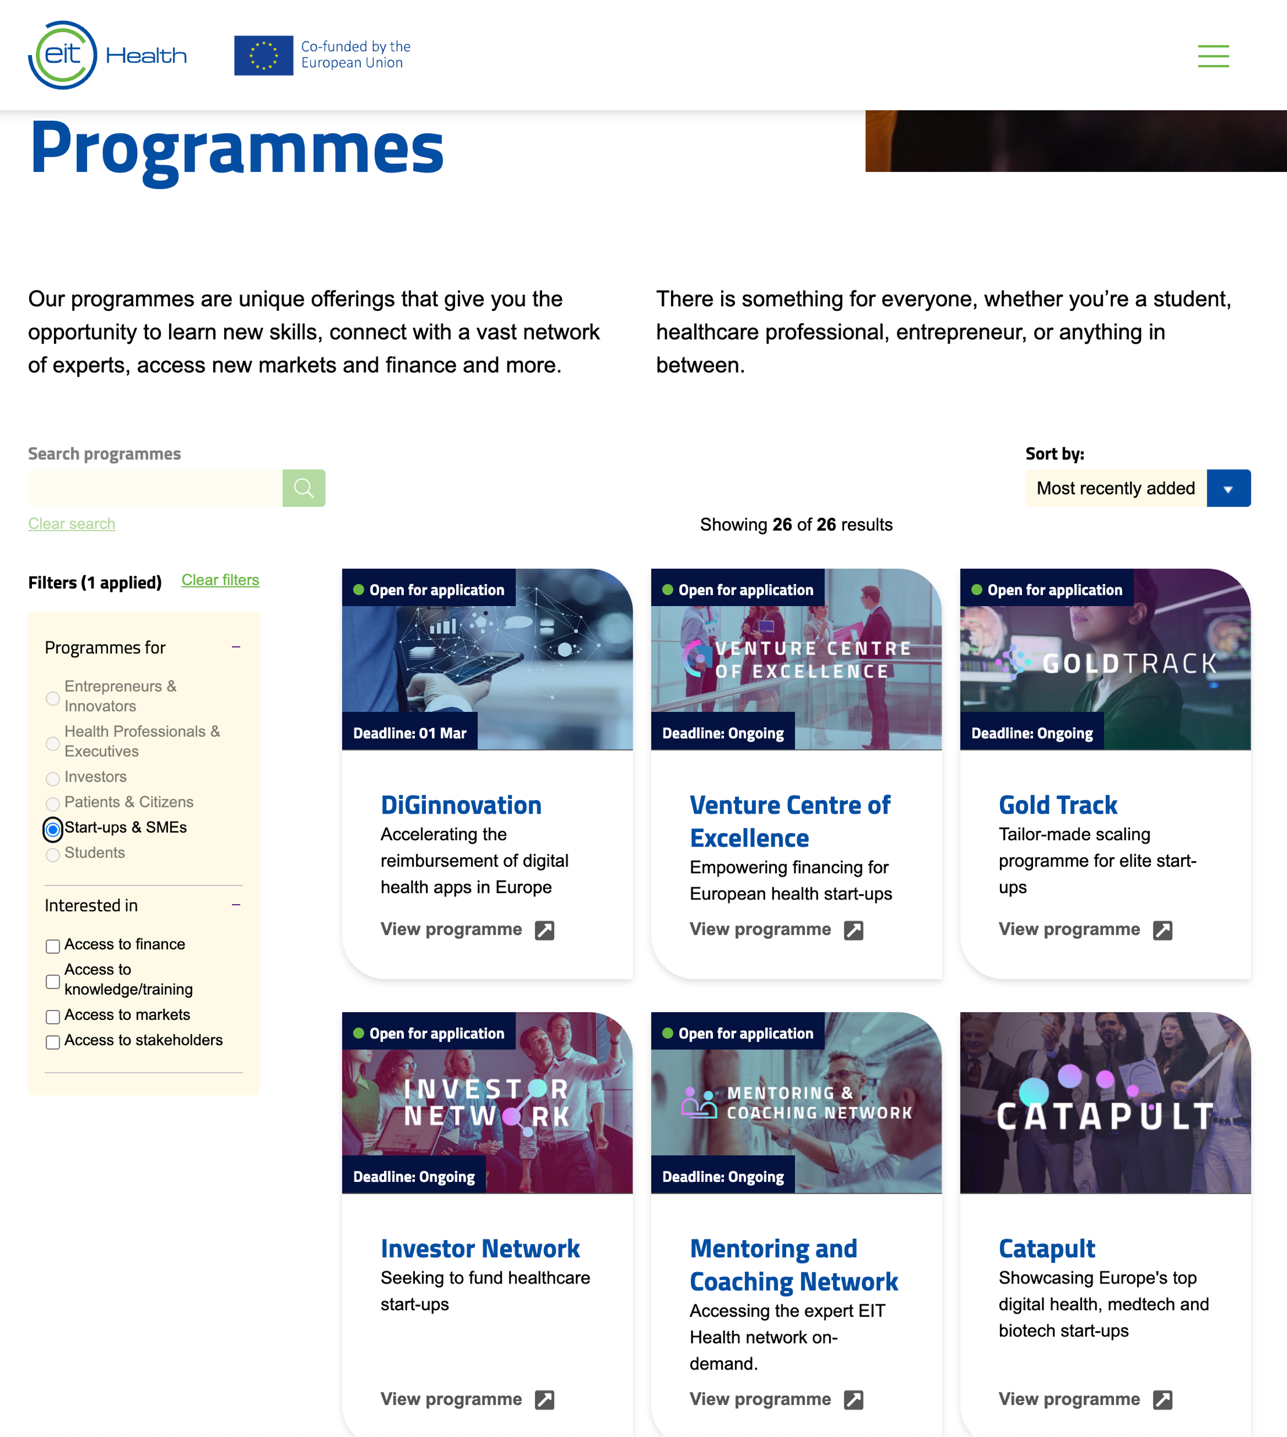
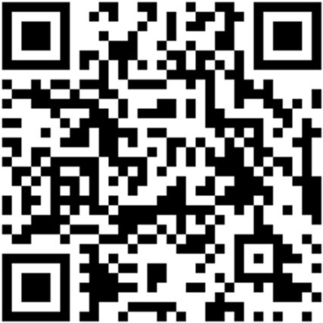
Database of support programs
Support schemas clustered based on the nature of target group
https://eithealth.eu/what-we-do/our-programmes/

Slide 19
EIT Health support for start-ups and SMEs by type
Through hands-on training such as the Bootcamp activities and Mentoring and Coaching Network
By diving into the network, e.g. through the EIT Start-ups meet Pharma & Healthcare Providers and the ULabs
Access to knowledge
Access to stakeholders
Within and beyond Europe, e.g. through the Bridgehead activity
Through our finance instruments such as the Crowdfunding, Investor Network and Venture Centre of Excellence activities
Our Investor readiness programmes such as the Catapult, Gold Track, Wild Card, and EIC pilot
Access to market
Access to funding and investor readiness

Slide 20
EIT Health support for start-ups and SMEs by maturity level
Entry Track
Scale-up Track
InvestHealth
Entry Track for early-stage companies that have begun their journey with our Partners, leading accelerators and incubators in Europe.
Scale-up track services for start-up companies beyond (pre-) seed phase, including those with first products in the market
Support access to finance and investor readiness – as a service
Intensive incubation programmes for start-ups
Bootcamps
Support entry into European and global markets
Bridgehead programme
Pan-EU investment opportunities
Crowdfunding (Aecuvest)
0,5-5 Mio €
Refine investor pitch and storytelling in Europe-wide competition
Catapult
Access to stakeholders and experts to support business growth
Gold Track
Access to equity
Investor Network
0,5-10 Mio €
Creating new business ventures from big ideas
Wild Card
Visibility to corporates
Start-ups Meet Pharma
Middle or Late-stage co-investment with corporates
Venture Centre of Excellence
10-20 Mio €
Helps healthcare startups achieve finance literacy
Finance Booster
Visibility to corporates
Start-ups Meet Healthcare Providers
Access top mentors at European level
Access top mentors at European level
Mentoring & Coaching Network
Mentoring & Coaching Network
Co-design validation studies
Ulabs
Co-design validation studies in living labs
Ulabs
FastTrack for EIC companies
EIT EIC Collab Pilot

Slide 21
EIT Health support for start-ups and SMEs in timeline

Slide 22
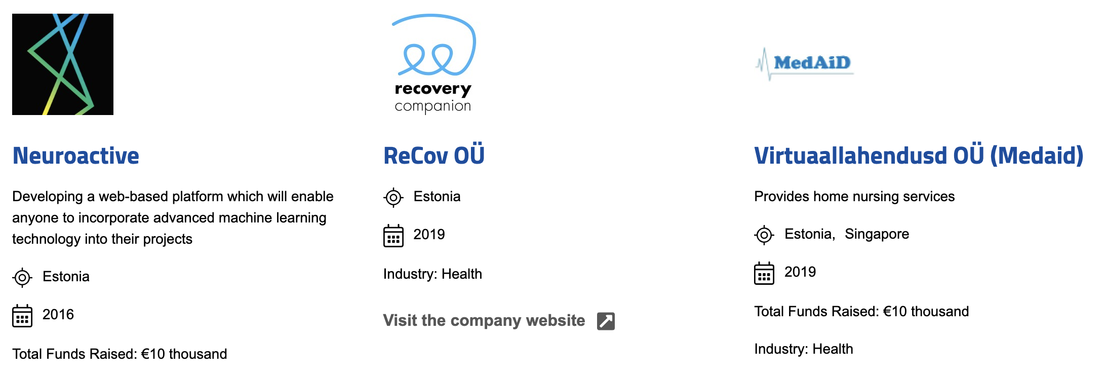
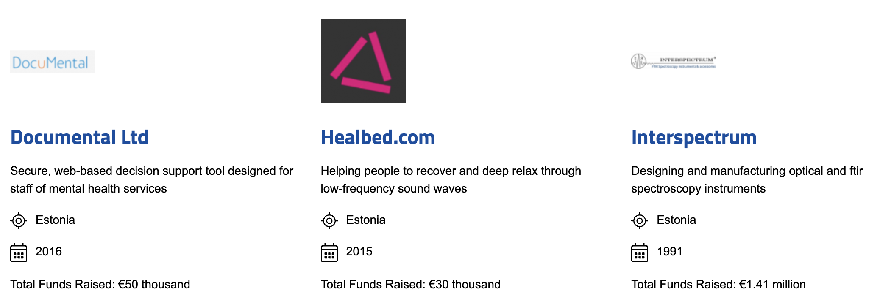
EIT Health support for Estonian start-ups
More information:
https://startups.eithealth.eu/

Slide 23
RIS innovation call
Currently closed, will be open again in 2023
More info: https://eithealth.eu/programmes/ris-innovation-call/
Max grant: 75 000 EUR
Application Deadline: 12th of October 2022
4 focus areas:
Brain and Mental Health
Infectious Diseases
Fostering Healthier Lives
Harnessing Real-World Data
This programme is open to all legal entities such as business organisations, academic, research and healthcare institutions that have innovation project at least TRL3 (Proof of concept) and are registered in the following targeted EIT RIS eligible Countries: Croatia, Czech Republic, Estonia, Greece, Hungary, Italy, Latvia, Lithuania, Poland, Portugal, Romania, Slovakia, and Slovenia.

Slide 24
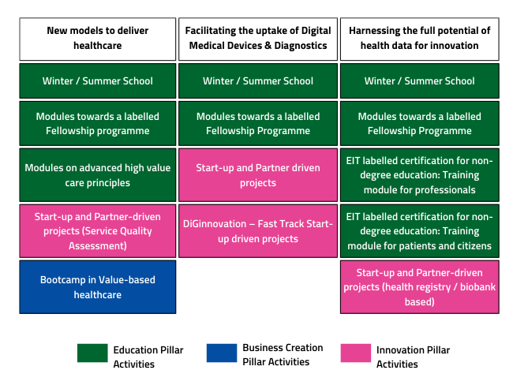
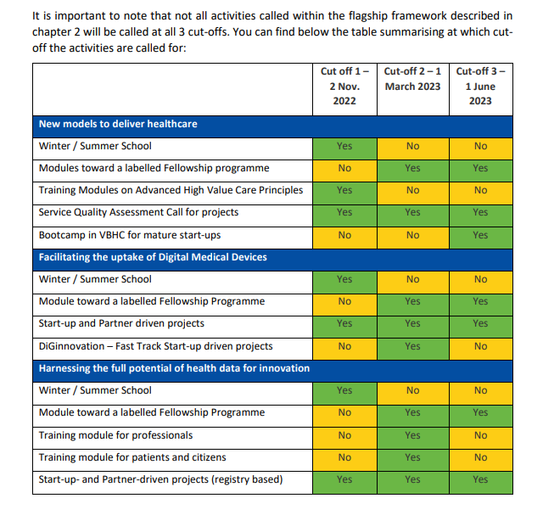
EIT Health Calls in 2022 for consortiums - hospitals, universities, start-ups
More information from Call Document:
https://eithealth.eu/opportunity/call-for-activities-related-to-the-flagships/

Slide 25
Overview of different Innovation calls
Type​ | Service Quality Assessment Innovation projects​ | Facilitating the uptake of Digital Medical Devices & Diagnostics​ | Harnessing the full potential of health data for Innovation​ | Fast Track Start-Up Driven Innovation Project (DiGinnovation)​
Goal​ | Build more resilient healthcare systems that work based on value, not on volume.​ | Launch innovative patient centred Digital Medical Devices into the market​ | Unleash the full potential of health data by exploring the secondary use for the development of innovative technologies or solutions that deliver outcomes that matter to patients​ | Receive reimbursement for innovative patient-centered Digital Medical Devices and launch these innovations on the market ​
IML start​ | IML 8, CE mark granted, only IT platform integration​ | IML 5 (Proof of Value) - 6 (Initial Clinical Trials)​ | IML 5 (Proof of Value) - 6 (Initial Clinical Trials)​ | IML7 (Validation of Solution) - IML8 (Approval & Launch), CE mark granted​
IML end​ | IML 9 (Clinical Use)​ | IML7 (Validation of Solution) - IML8 (Approval & Launch)​ | IML7 (Validation of Solution) - IML8 (Approval & Launch)​ | IML9 (Clinical Use)​
Duration​ | Max 30 months, ​ till Dec 2025​ | Max 24 months, ​ till Dec 2025​ | Max 24 months, ​ till Dec 2025​ | Max 9 months​
EIT Grant​ | Max 2M EUR, max 850K EUR/Y​ | Max 1,5 M EUR, max 850K EUR/Y​ | 1,5 M EUR, max 850K EUR/Y​ | Max 350 K EUR​
Specificities​ | 2 HC providers identified at short proposal​ 2 payers​ IT platform integration​ Replicability beyond project end​ Health economics​ | On the market in 1 year after project end​ | Access to use of data repositories/registers or biobanks​ On the market in 1 year after project end​ | On the market in 1 year after project end​
Clinical Dossier​ | 1 ethics approval before start​ ​
Consortium​ | At short proposal: 2 entities​ At full proposal: Min 50% partners, 2 countries, industry + non-industry​ |  |  | -At short: Start-up alone​ -At full proposal: > 2 entities, 50% partners​
For Startup driven​ projects​ | <10 Y , 2 paid FTE, full time CEO​ SU at least 300 K EUR – 500 K EUR​ |  |  | <10 Y , 2 paid FTE, full time CEO​ SU at least 150K EUR​

Slide 26
Min. requirements for consortiums of innovation projects
· At least 50% of the project entities must be EIT Heath registered members at the full proposal submission stage
Involvement of industry, healthcare provider and other stakeholders from a minimum of two countries from two different Regional Innovation Hubs.
Start-up is a for-profit SME according to the EU definition – an enterprise which employs fewer than 250 persons and which has an annual turnover not exceeding 50 million euro, and/or an annual balance sheet total not exceeding 43 million euro.
Start-up should be legally incorporated and established in one of the EU Member States or Horizon Europe associated countries. Be incorporated on/after 1st January 2013 and before the submission deadline, have full-time CEO and 2 FTE at the time of submission of short proposal.
New Models to deliver Healthcare | Facilitating the uptake of Digital Medical Devices (Partner/Start-Up Driven Innovation Project) | Harnessing the full potential of health data for innovation
Includes two healthcare providers and their corresponding payer/s; industry; IT platform integrator; entity with health economic expertise Balanced in terms of expertise and activities or missing competences identified Includes a commercialising entity supporting replicability of approach in further country locations Commercialising entity confirms agreement to backflow model or grant-for-options (for start-ups driven project only) In case start-up goes with backflow model, it will be asked to pay partner fees in case the proposal will be funded (choice between both models must be done at short proposal stage) |  | Relevant privileges to access health registry or biobank (to facilitate health registry- or biobank-based clinical study) in place before project start.
 | Balanced in terms of expertise and activities or missing competences identified Includes a commercialising entity (industry) Commercialising entity confirms agreement to backflow model or grant-for-options (for start-up driven projects only) In case start-up goes with backflow model, it will be asked to pay partner fees in case the proposal will be funded (choice between both models should be done at short proposal stage)

Slide 27
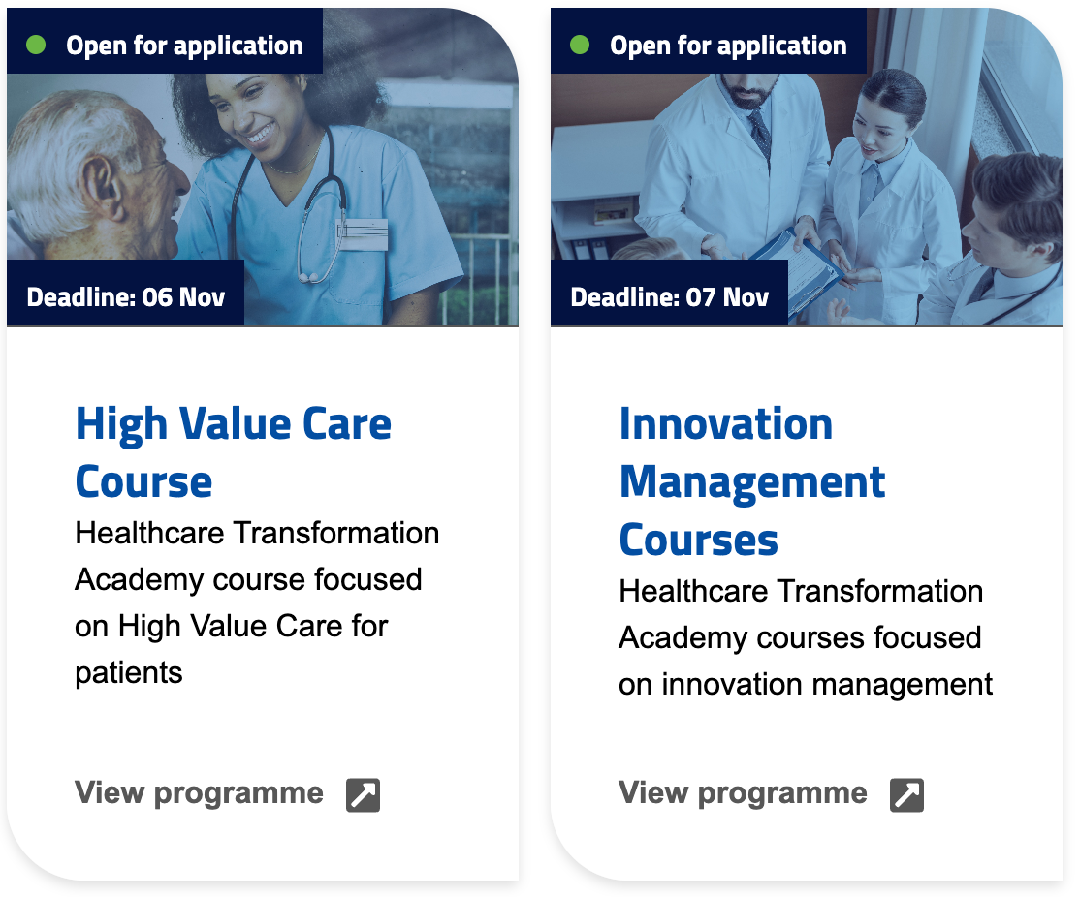
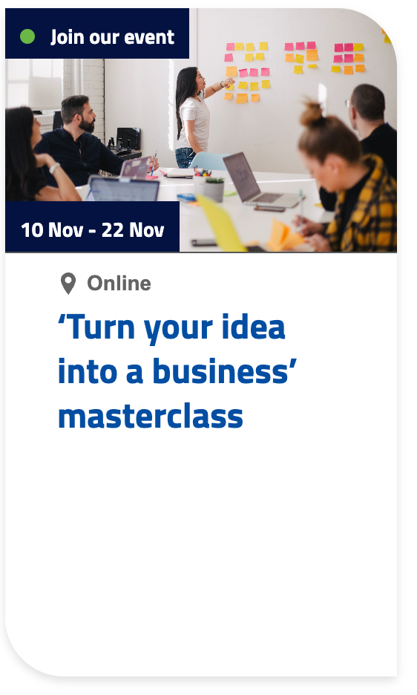
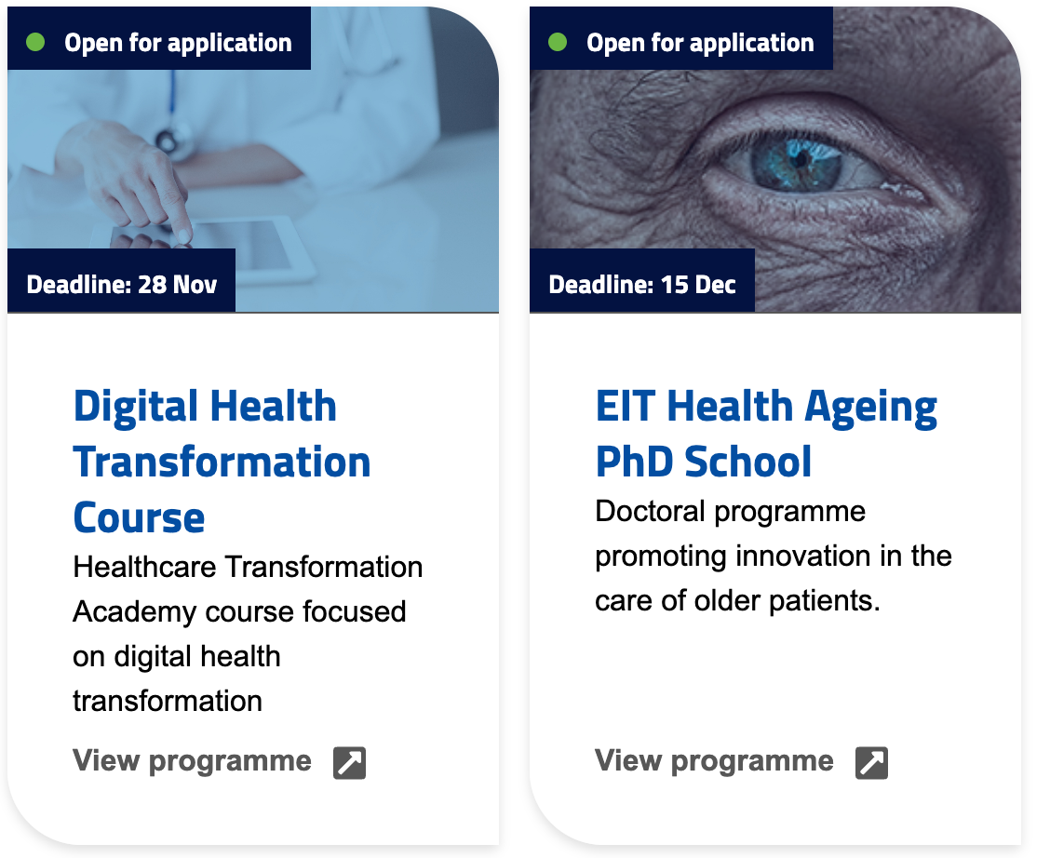
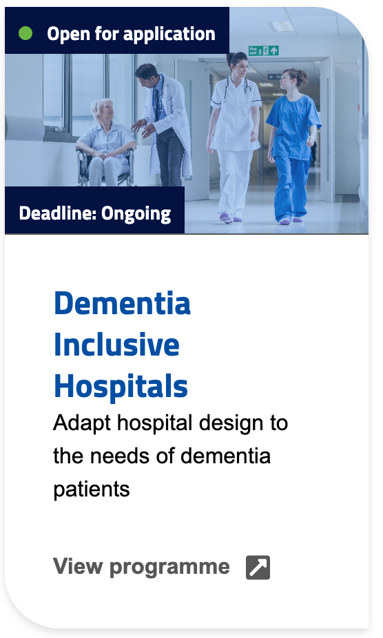
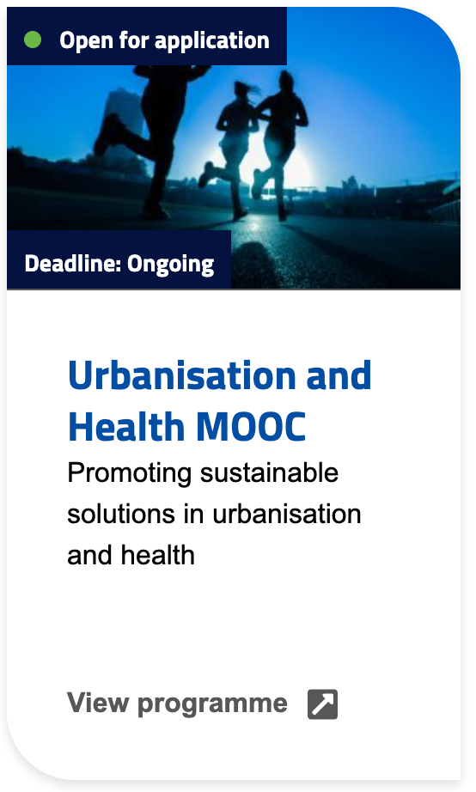
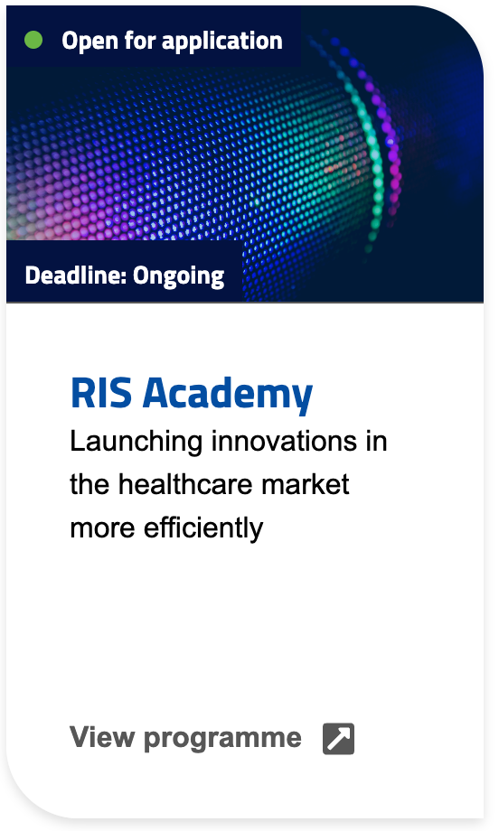
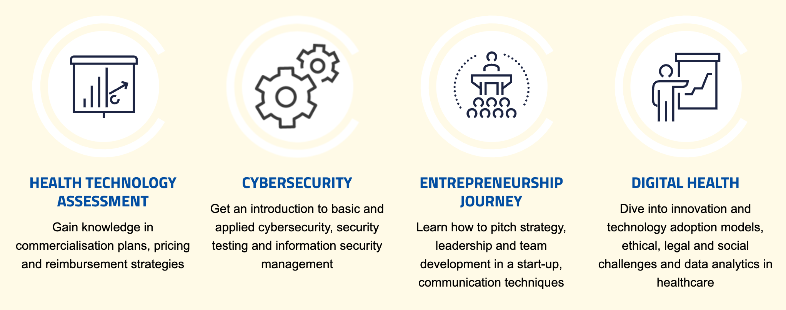
EIT Health training programs for students and innovators
Look more:
https://eithealth.eu/get-involved/events-and-opportunities/

Slide 28
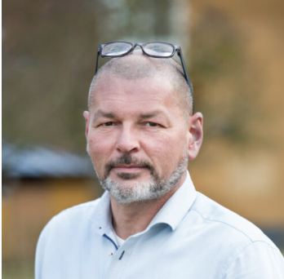
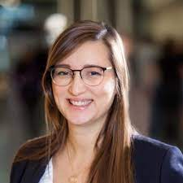
Where to get help?
University of Tartu (partner id: 0130) is partner since 2016
Master contact: Kadi Erik, kadi.erik@ut.ee, Vallo Mulk, vallo.mulk@ut.ee
Tartu University Hospital (partner id: 0130-1) is Linked Third Party (LTP) to Tartu University since 2019.
Master contact: Katrin Kaarna, katrin.kaarna@kliinikum.ee
Tartu Biotechnology Park (partner ID: 0331) – RIS HUB, external project partner, under Innostars since 2019.
Main contact point in Tartu Biotechnology Park: Maire Külvik, marie@biopark.ee, Sven Parkel
Country representative in EIT Health – Merike Leego, merike.leego@eithealth.eu, +372 5281488
EIT Health Scandinavia support person regarding projects for start-ups – Entrepreneurship lead Per Horn, per.horn@eithealth.eu
EIT Health Scandinavia support person in consortium preparation for innovation projects – Collaboration lead Zara Pons Vila, zara.pons-vila@eithealth.eu

Slide 29
Where to get help – events
​​Want to find a partner to your consortia-based new proposal? 5-6 December 2022, Tallinn, Radisson SAS Collections, central topics: “New Models to Deliver Healthcare” and “Harnessing the Full Potential of Health Data for Innovation”.​
Register (start-ups: on-line 75 EUR, in-person 100 EUR):
https://eithealth.eventscase.com/EN/matchmakingtallinn
​
Online career fair that will bring together 20 companies and starts-ups from Digital Health, MedTech and Biotech and more than 200 students.
Register for free:
https://eithealth.eventscase.com/EN/workinhealthonlinecareerfair

Slide 30
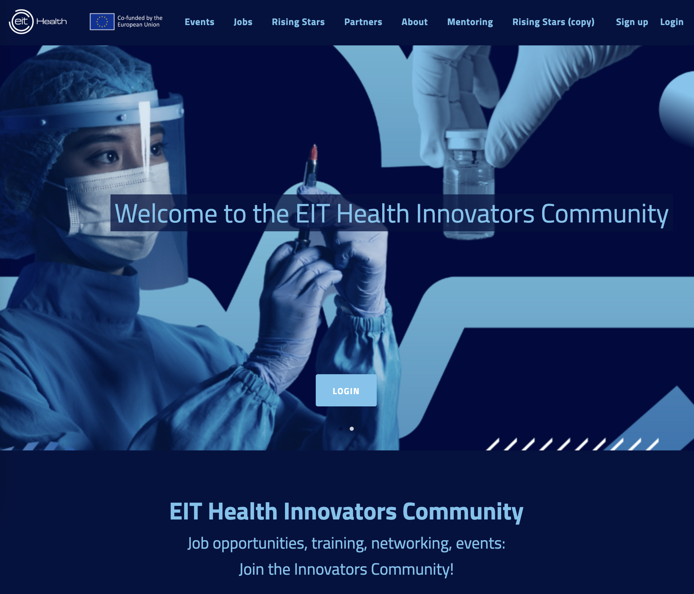
Where to get help – Alumni Network - A multidisciplinary community of innovators
​​
> 2000 members of the network can:
Participate in EIT H training of their choice
Win free tickets to the main health summits in Europe
Join Slack groups on topics of your interest
Become a coach for fellow alumni
Receive exclusive job and internship opportunities from EIT Health partners
Design their own event in international teams
Sign up for Alumni network newsletter: https://community.eithealth.eu/signup
https://community.eithealth.eu/

Slide 31
To summarize …
EC has many support programs to facilitate innovation depending on the maturity of the idea - the biggest ones are EIC and EIT.
As a next step
Join the communities and newsletters
Look out what different programs offer
Contact the facilitators
Use wisely the support programs and start implementing your idea!
Access to knowledge
Access to stakeholders
Access to market
Access to funding and investor readiness

Slide 32
Thank you!
Merike Leego, MBA, MSc, Innovation Lead
Phone: +46 731 553 023, +372 5281488, Merike.Leego@eithealth.eu
Vist us: Stockholm Flatiron Building
​
EIT Health Scandinavia Torsgatan 11, 8th floor 111 23 Stockholm, Sweden EIT Health e.V. Mies-van-der-Rohe-Str 1C 80807 Munich, Germany

